Slide 1
Hunter Expert Controller Qualification Seminar

Slide 2
Installation Practices
Installation Details
A
G
E
N
D
A
ACC99D Controller Hardware
ICORE/DUAL Controller Hardware
Station Output Hardware
System Diagnostics
2-Wire Field Components
Decoder Design
Grounding Installation Details
ClikTM Sensor
Flow Sensors
Troubleshooting
Test

Slide 3
Installation Practices

Slide 4
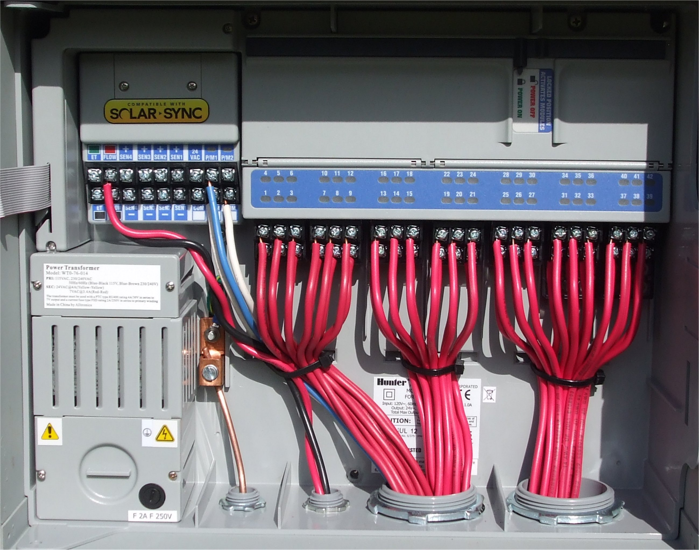
Field / Controller Wiring

Slide 5
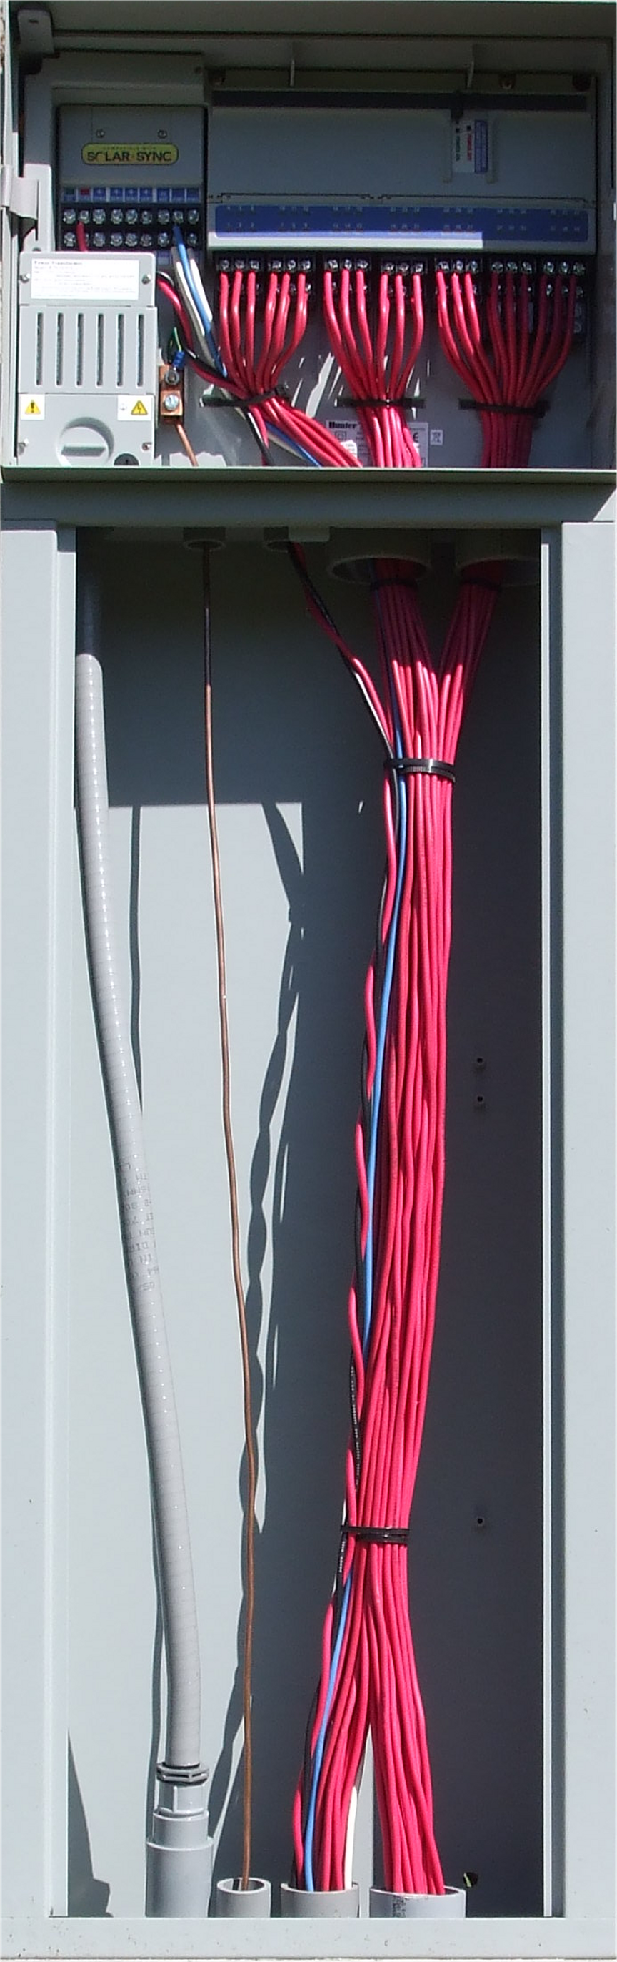
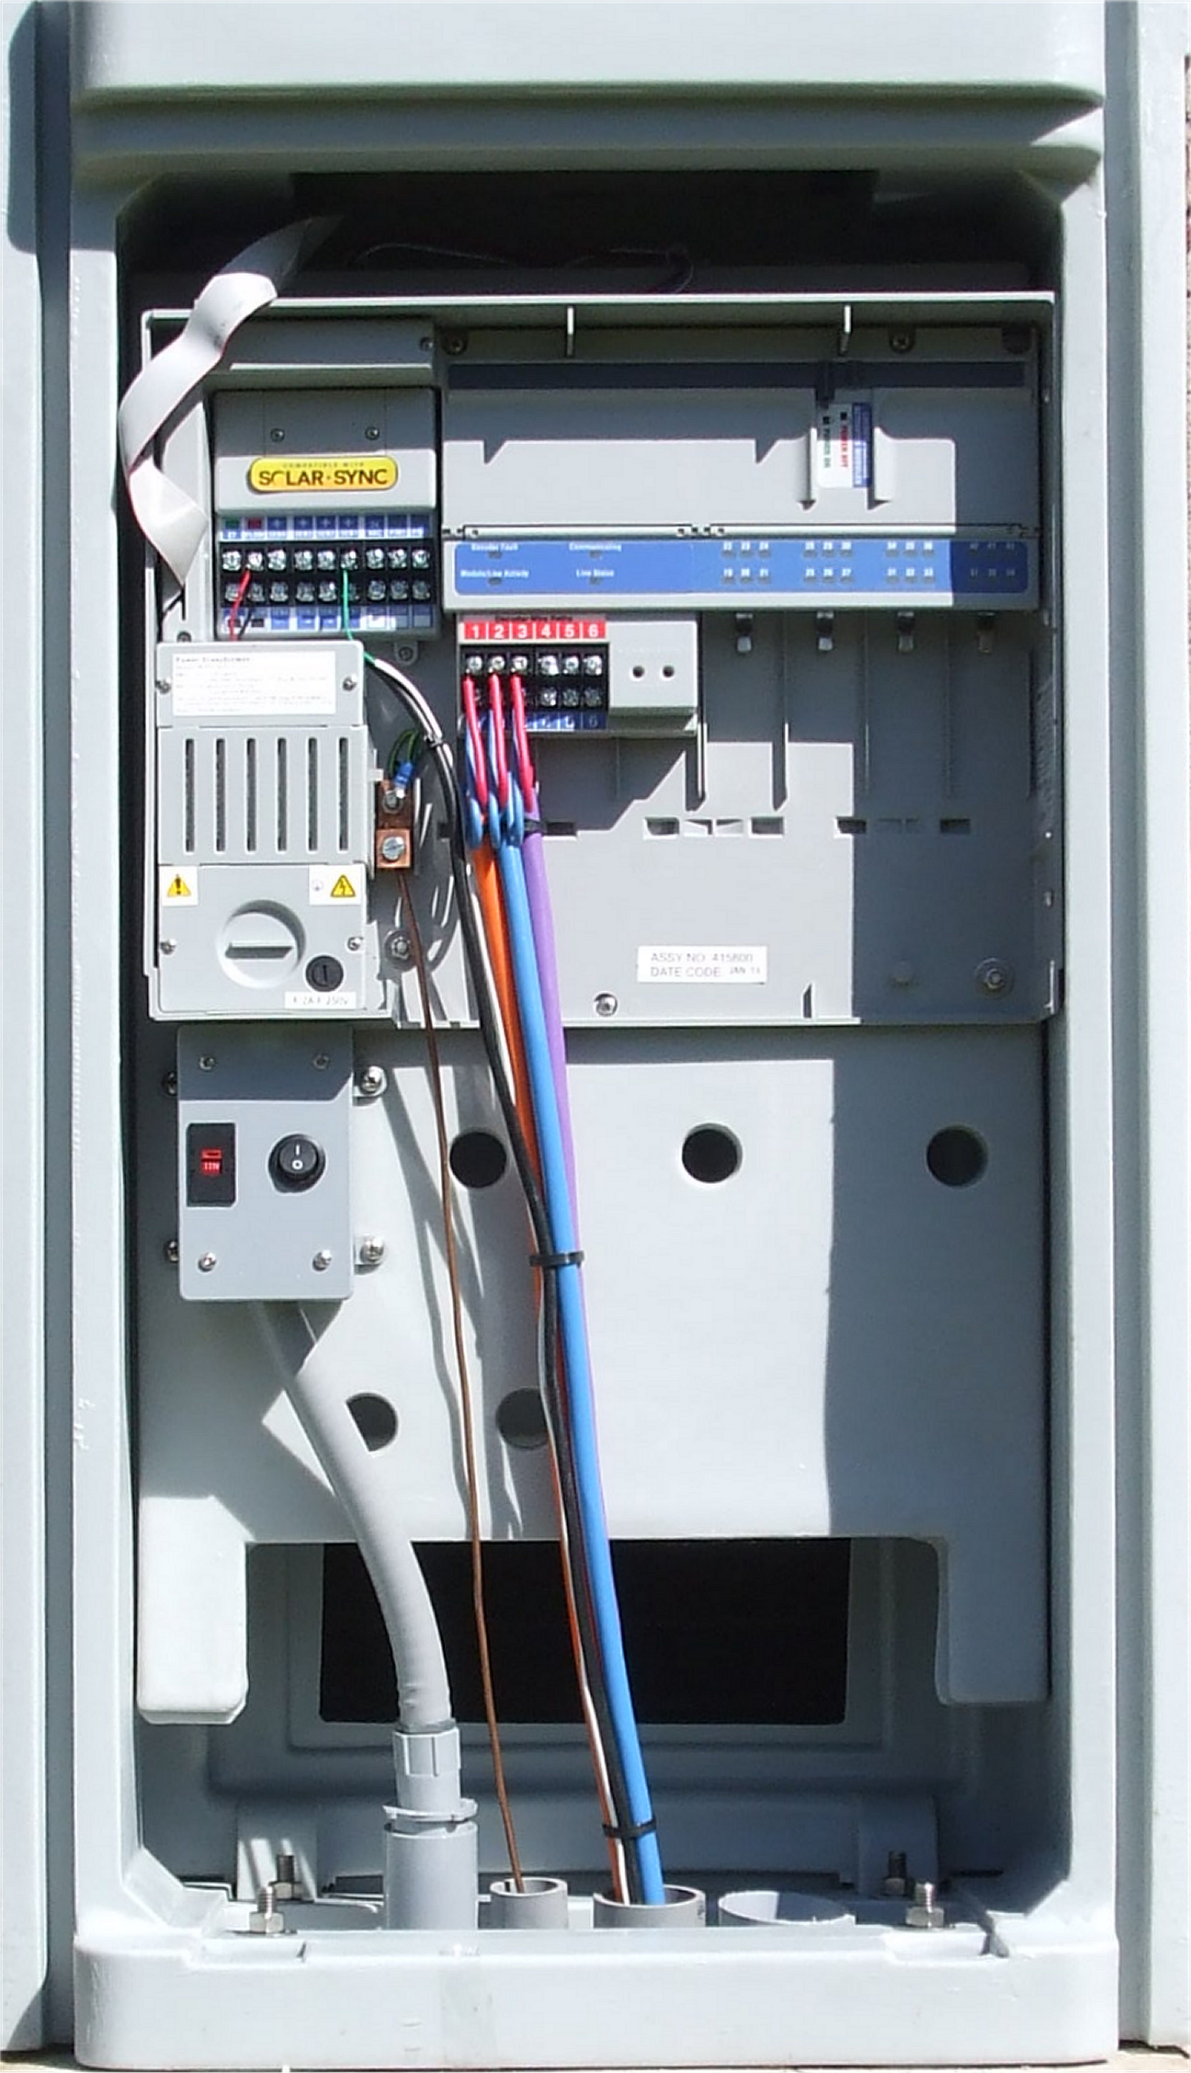
Field / Controller Wiring

Slide 6
ACC Installation Details

Slide 7
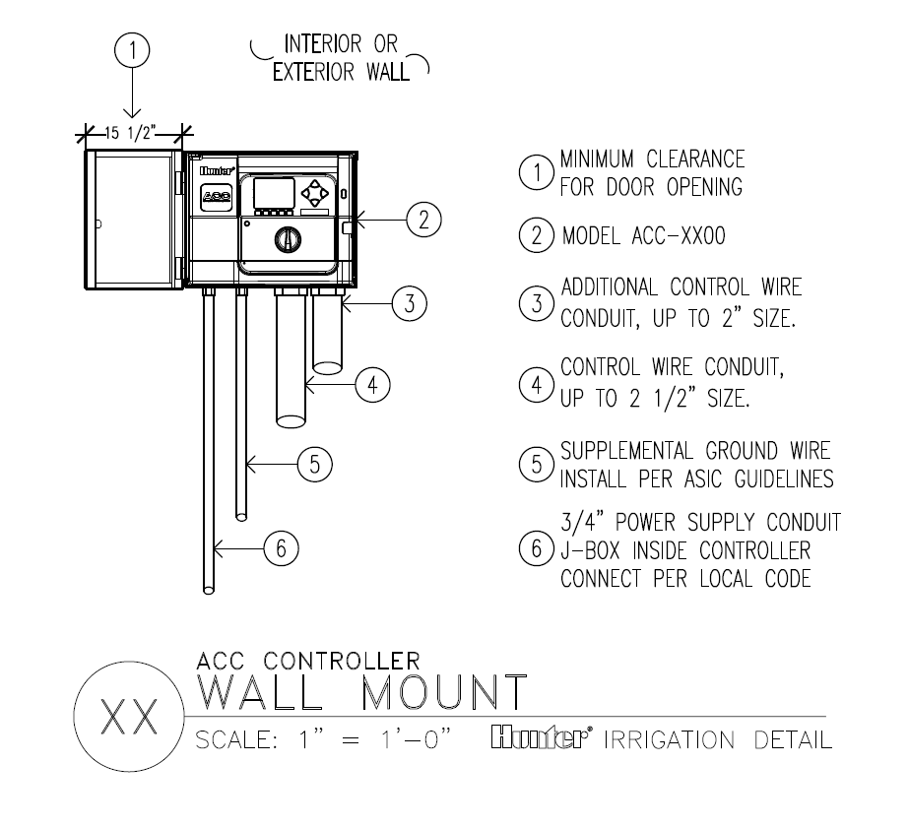
ACC Installation Details

Slide 8
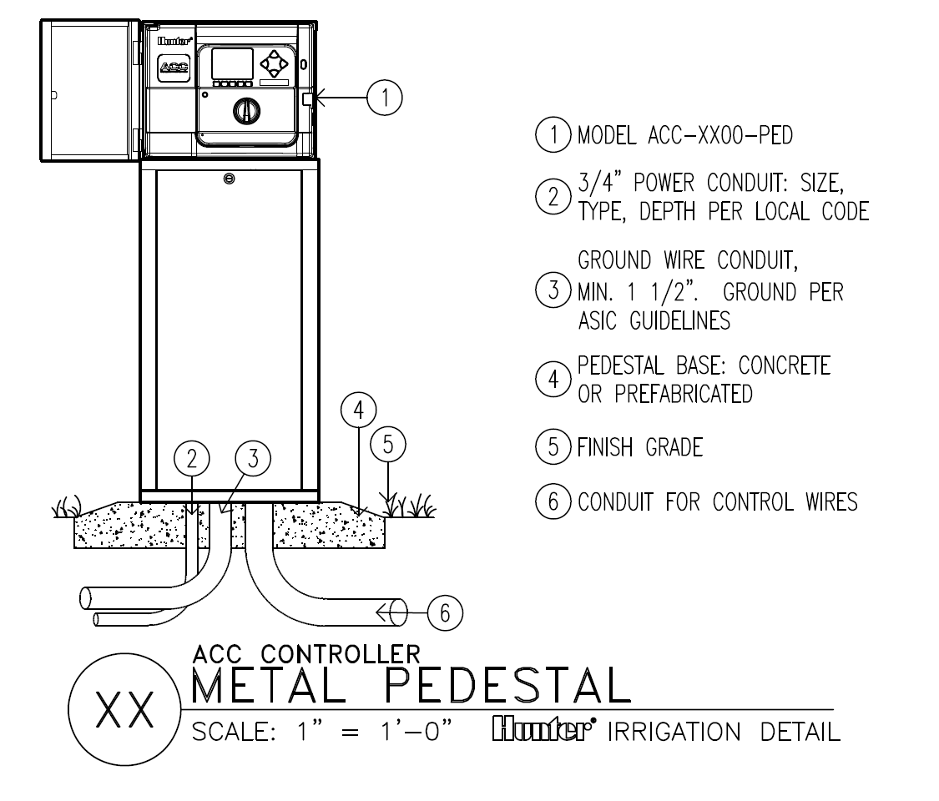
ACC Installation Details

Slide 9
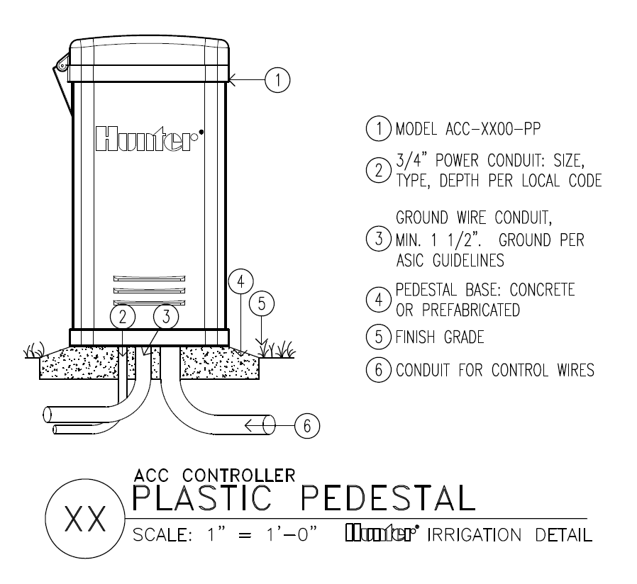
ACC Installation Details

Slide 10
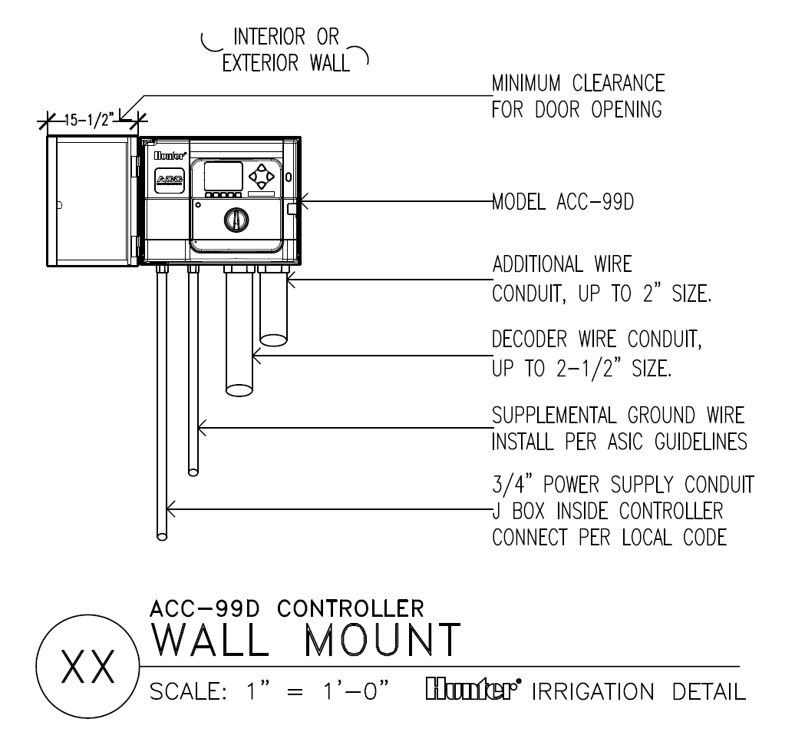
ACC Installation Details

Slide 11
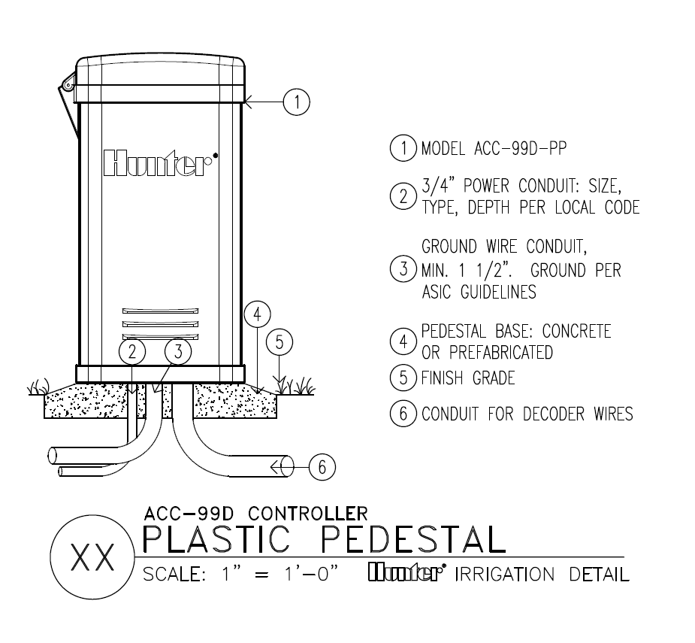
ACC Installation Details

Slide 12
ACC Electrical Details

Slide 13
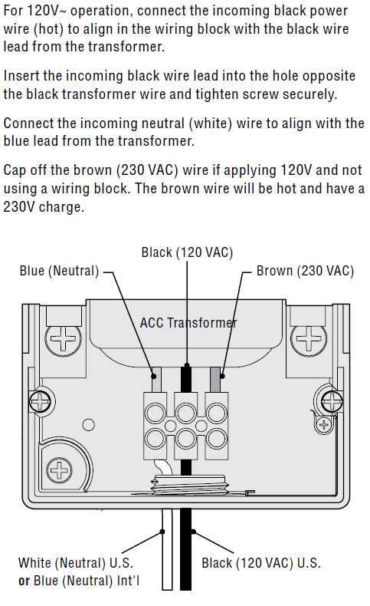
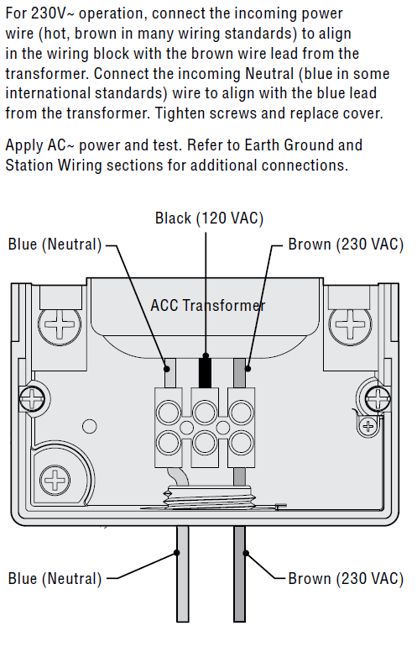
ACC Transformer

Slide 14
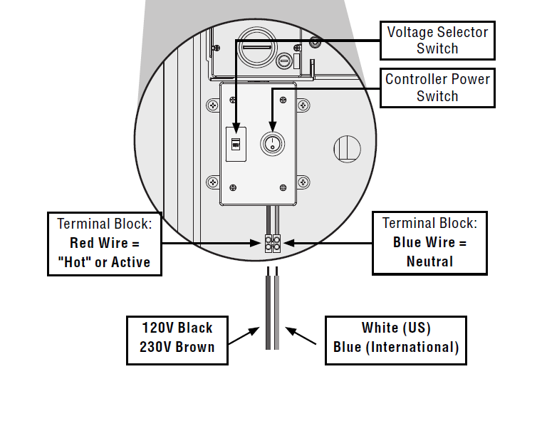
ACC Transformer

Slide 15
The green, or green-and-yellow safety ground (service ground) is not required or permitted with this floating ground, double-insulated transformer.
ACC Transformer

Slide 16
ACC Controller Components

Slide 17
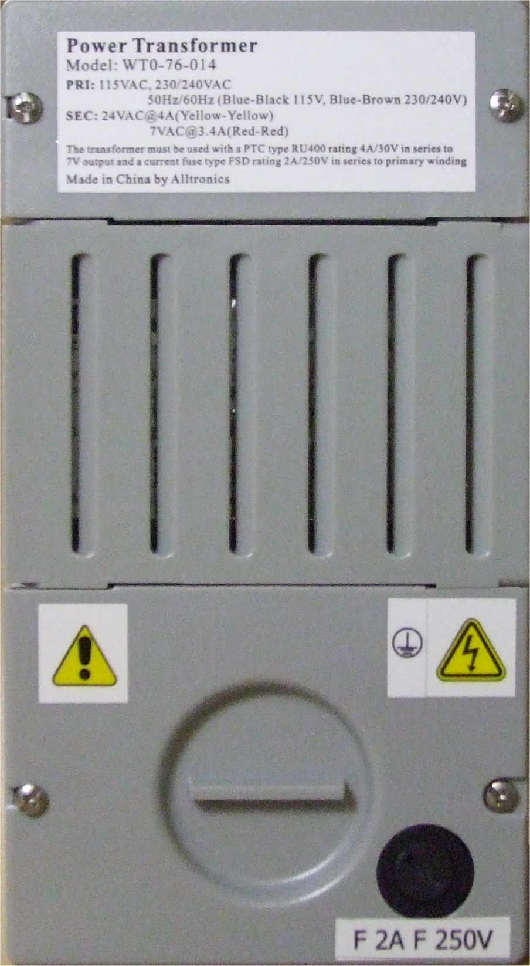
5
8
7
0
0
0
ACC Transformer

Slide 18
Secondary Power Connection Compartment
24Vac @ 4 Amp. = Yellow
7Vac @ 3.4 Amp. = Red
Primary Power Connection Compartment
115Vac, 230Vac/240Vac
Hot and Neutral, NO Ground
Controller Fuse (¹/₄ Turn)
2 Amp. @ 250V Fast Blow
5 X 20 mm
ACC Transformer

Slide 19
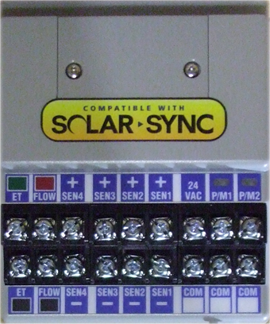
5
7
2
0
0
0
ACC Master Module

Slide 20
F
I
R
M
W
A
R
E
2.02.017 24Vac
4.22.010 IMMS-ET
5.23.008 SolarSync
ACC Master Module

Slide 21
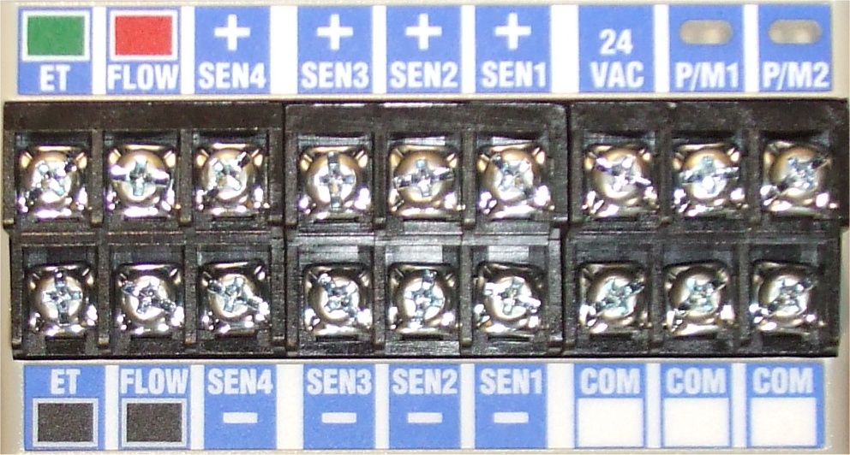
IMMS ET / SolarSync Connections
24Vdc – 19Vdc Minimum
ACC Master Module

Slide 22
Flow Sensor Connections
24Vdc – 19Vdc Minimum
HFS or 200 Series Badger Flow Sensors
ACC Master Module

Slide 23
Clik™ Sensor Connections
Normally Closed Circuits
ACC Master Module

Slide 24
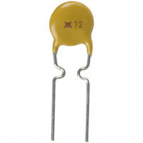
24Vac Power Connection
400Ma (PTC protected)
~Positive Temperature Coefficient~
ACC Master Module

Slide 25
P/MV1 and P/MV2 Connections
0.32 Amp @ 24Vac
ACC Master Module

Slide 26
P/MV1 and P/MV2 on Power-up
Flashing = Communications
ACC Master Module

Slide 27
P/MV1 and P/MV2 when Active
Green = Active, no Over-currents
ACC Master Module

Slide 28
P/MV1 and P/MV2 when Over-current
Flashing Red = Overcurrent
ACC Master Module

Slide 29
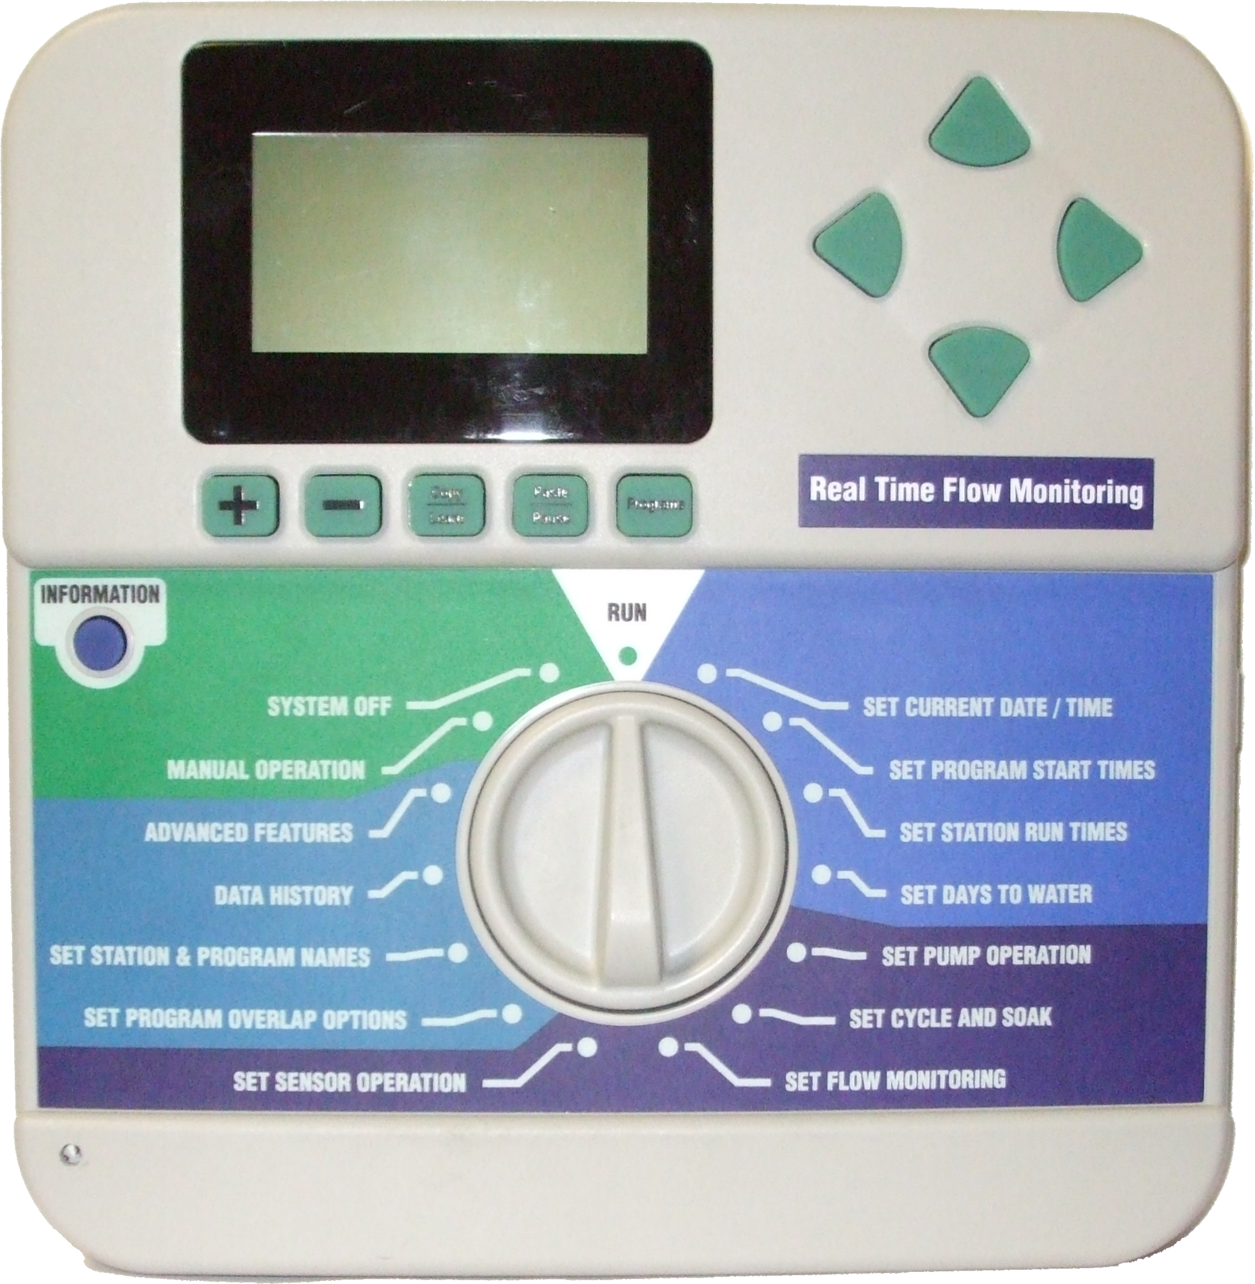
5
7
1
5
0
0

Slide 30
F
I
R
M
W
A
R
E
1009BFF 24Vac
2.00.25 Decoder
3.01.00 IMMS Central
3.12.02 Sensor Decoder
4.01.03 IMMS-ET
5.01.002 SolarSync
571500 ~ ACC Facepack

Slide 31
P
R
O
G
R
A
M
571500 ~ ACC Facepack

Slide 32
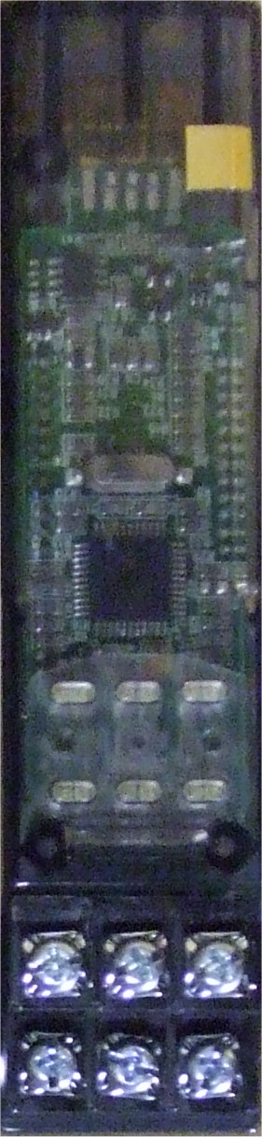
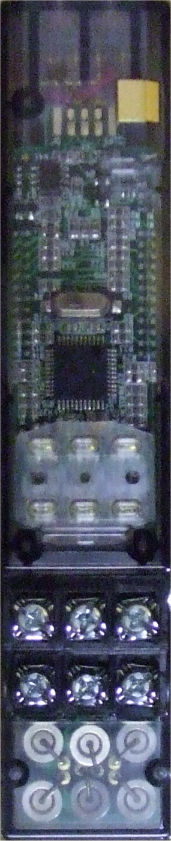
A
C/G
M
6
0
0
ACM-600
AGM-600
ACC Station Modules

Slide 33
F
I
R
M
W
A
R
E
1.03.003 Original
1.04.001 Increased Holding
Current
2.01.005 Enhanced
Diagnostics
ACC Station Modules

Slide 34
ACM-600
AGM-600
ACC Station Modules
6-Station, Standard Lightning Protection
6-Station, Heavy-Duty Lightning Protection
ACC Station Modules

Slide 35
ACM-600
AGM-600
ACC Station Modules
0.56 Amp @ 24Vac
ACC Station Modules

Slide 36
Station Outputs when Active
Green = Active, no Over-currents
0.56 Amp @ 24Vac
ACC Station Modules

Slide 37
Station Outputs when Over-current
Flashing Red = Overcurrent
ACC Station Modules

Slide 38
1.
0
3.
0
0
3
1.
0
4.
0
0
1
2.
0
1.
0
0
5
Station Outputs During Power-up
Red LED Indicators
ACC Station Modules

Slide 39
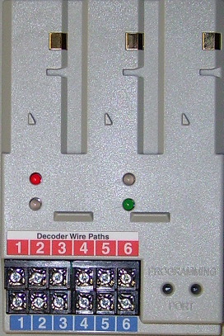
A
D M 9
9
ACC Decoder Module

Slide 40
F
I
R
M
W
A
R
E
1.02.003 Original
2.00.020 Enhanced
Communications
2.00.024 Enhanced
Diagnostics
ADM-99

Slide 41
Decoder Module
Indicator LEDs
Multiple
2-Wire
Paths
Decoder
Programming
Port
ADM-99

Slide 42
Decoder Fault
Communicating
Module/Line Activity
Line Status
Blank / OFF = Normal, All is good
Steady RED = ADM Problem
Blinking RED = Solenoid Shorted /
No Decoder Comm
ADM-99

Slide 43
Decoder Fault
Communicating
Module/Line Activity
Line Status
Blank / OFF = Normal, No Irrigation
Blinking Green = Irrigating Station
Steady RED = ADM Problem
Blinking RED = Solenoid Short /
No Decoder Comm
ADM-99

Slide 44
Decoder Fault
Communicating
Module/Line Activity
Line Status
Blank / OFF = No Communications
Blinking Green = 2-Wire Path Communications
Blinking Amber = Programming Port
Communications
ADM-99

Slide 45
Decoder Fault
Communicating
Module/Line Activity
Line Status
Blank / OFF = ADM Problem
Blinking Green = ADM Problem
Steady Green = Normal, All is Good
ADM-99

Slide 46
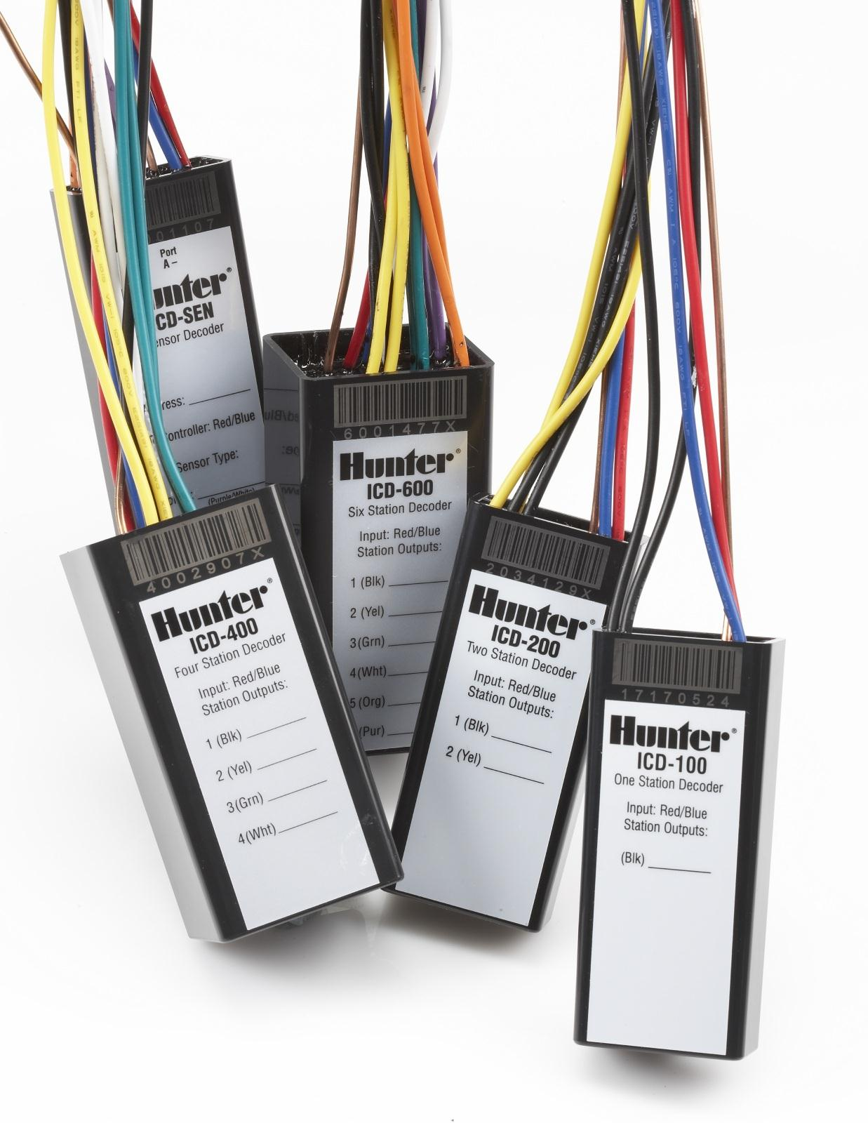
1, 2, 4, 6 station decoder
Flow/Clik sensor decoder
Surge protection on each decoder
2 solenoids per output
2-way communications
ICD Decoders

Slide 47
Q & A
170

Slide 48
ICORE Installation Details

Slide 49
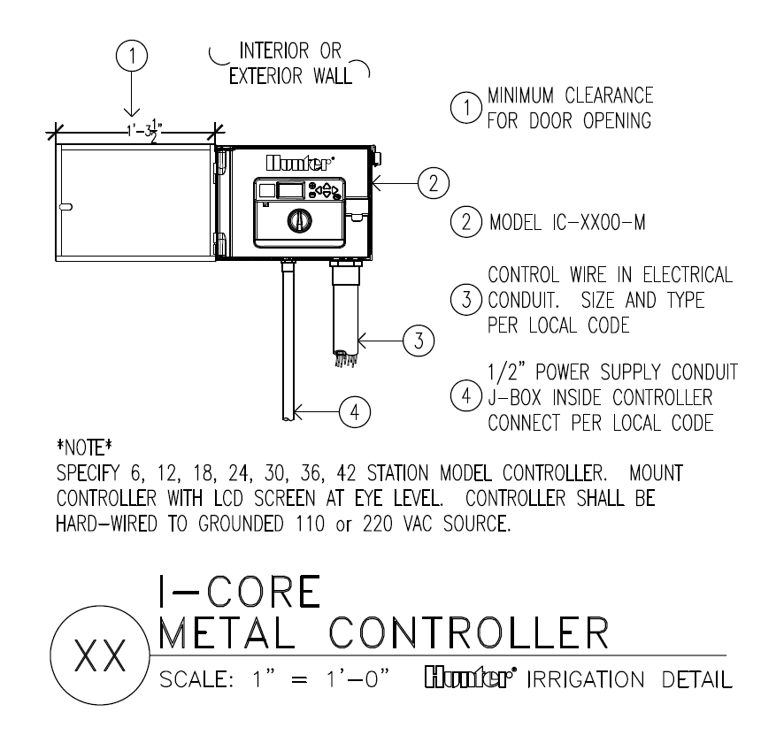
ICORE Installation Details

Slide 50
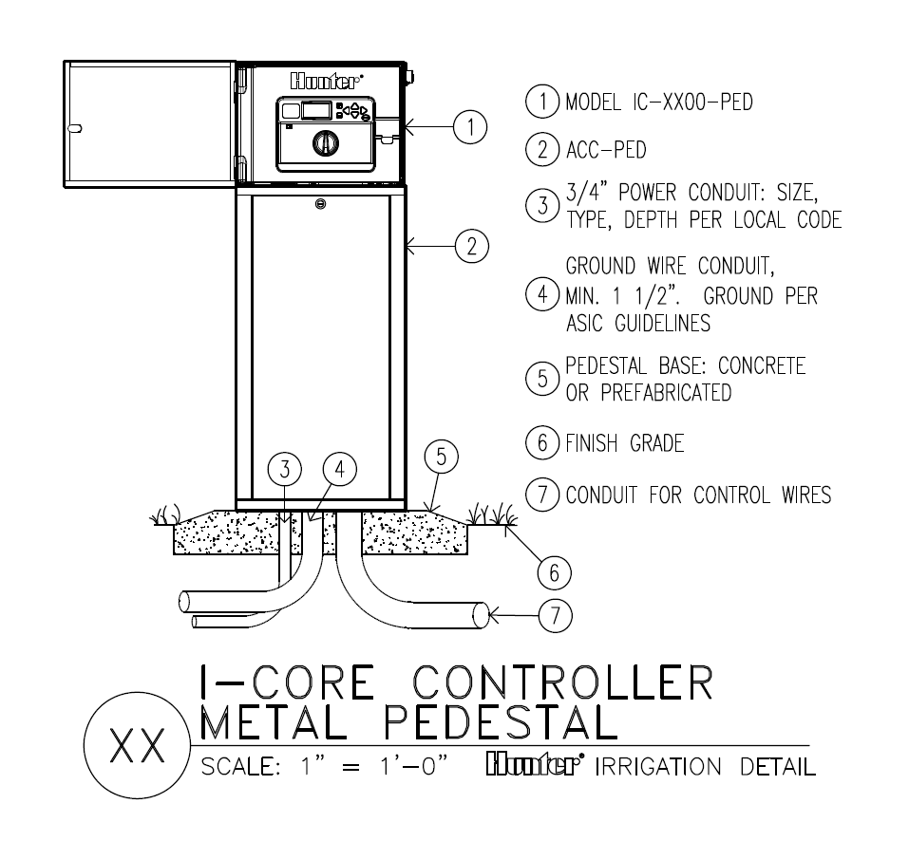
ICORE Installation Details

Slide 51
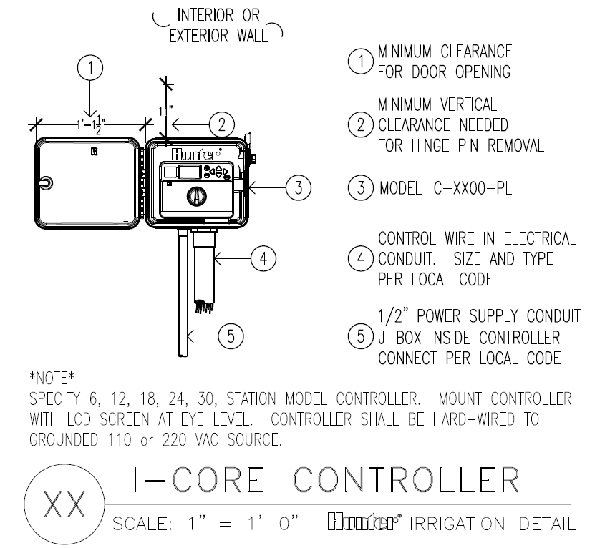
ICORE Installation Details

Slide 52
ICORE Installation Details

Slide 53
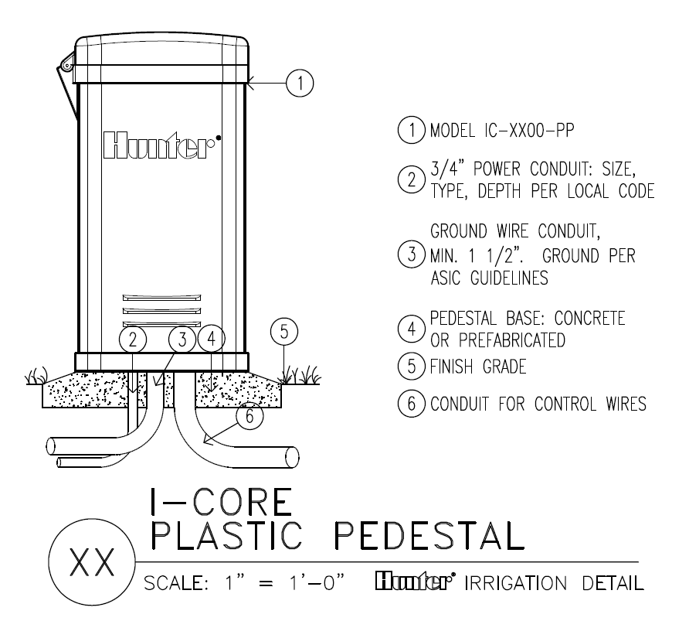
ICORE Installation Details

Slide 54
ICORE Electrical Details

Slide 55
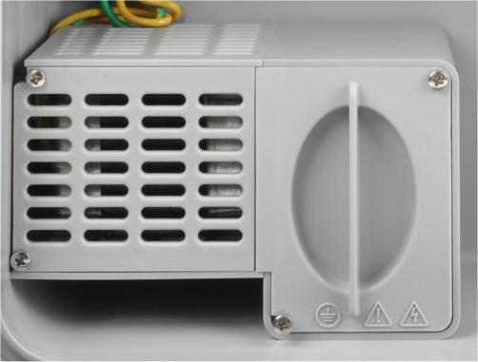
1
5
4
6
2
8
Secondary Power
24Vac @ 1.6 Amp. = Yellow
Primary Power Connection Compartment
115Vac, 230Vac/240Vac
Hot, Neutral and Ground
ICORE Transformer

Slide 56
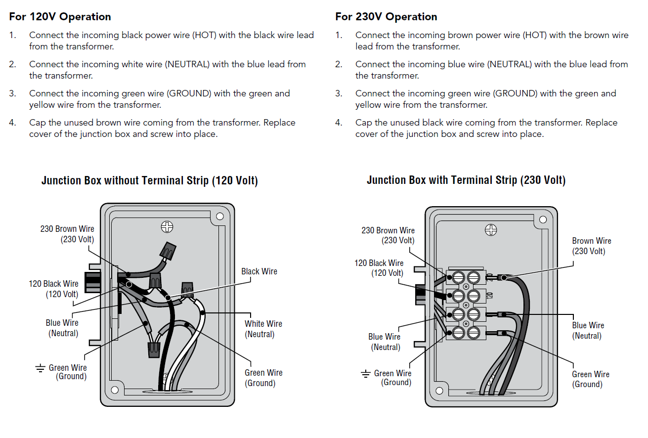
ICORE Transformer

Slide 57
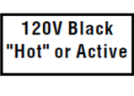
ICORE Transformer

Slide 58
ICORE Controller Components

Slide 59
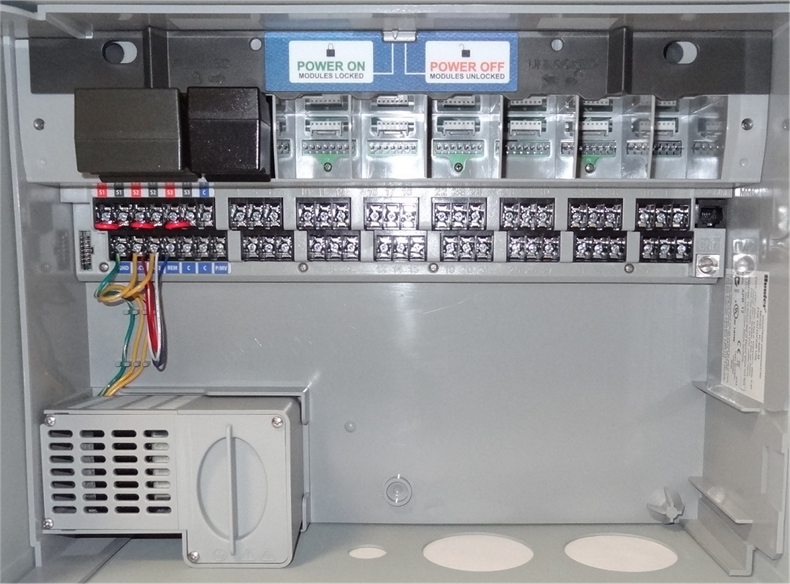
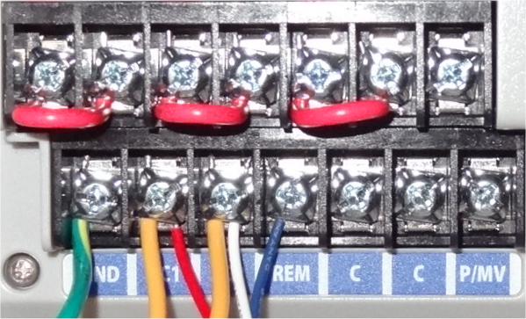
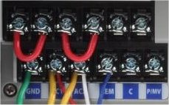
M
A
S
T
E
R
M
O
D
S
141700 (Metal)
121405 (Plastic)
ICORE Master Modules

Slide 60
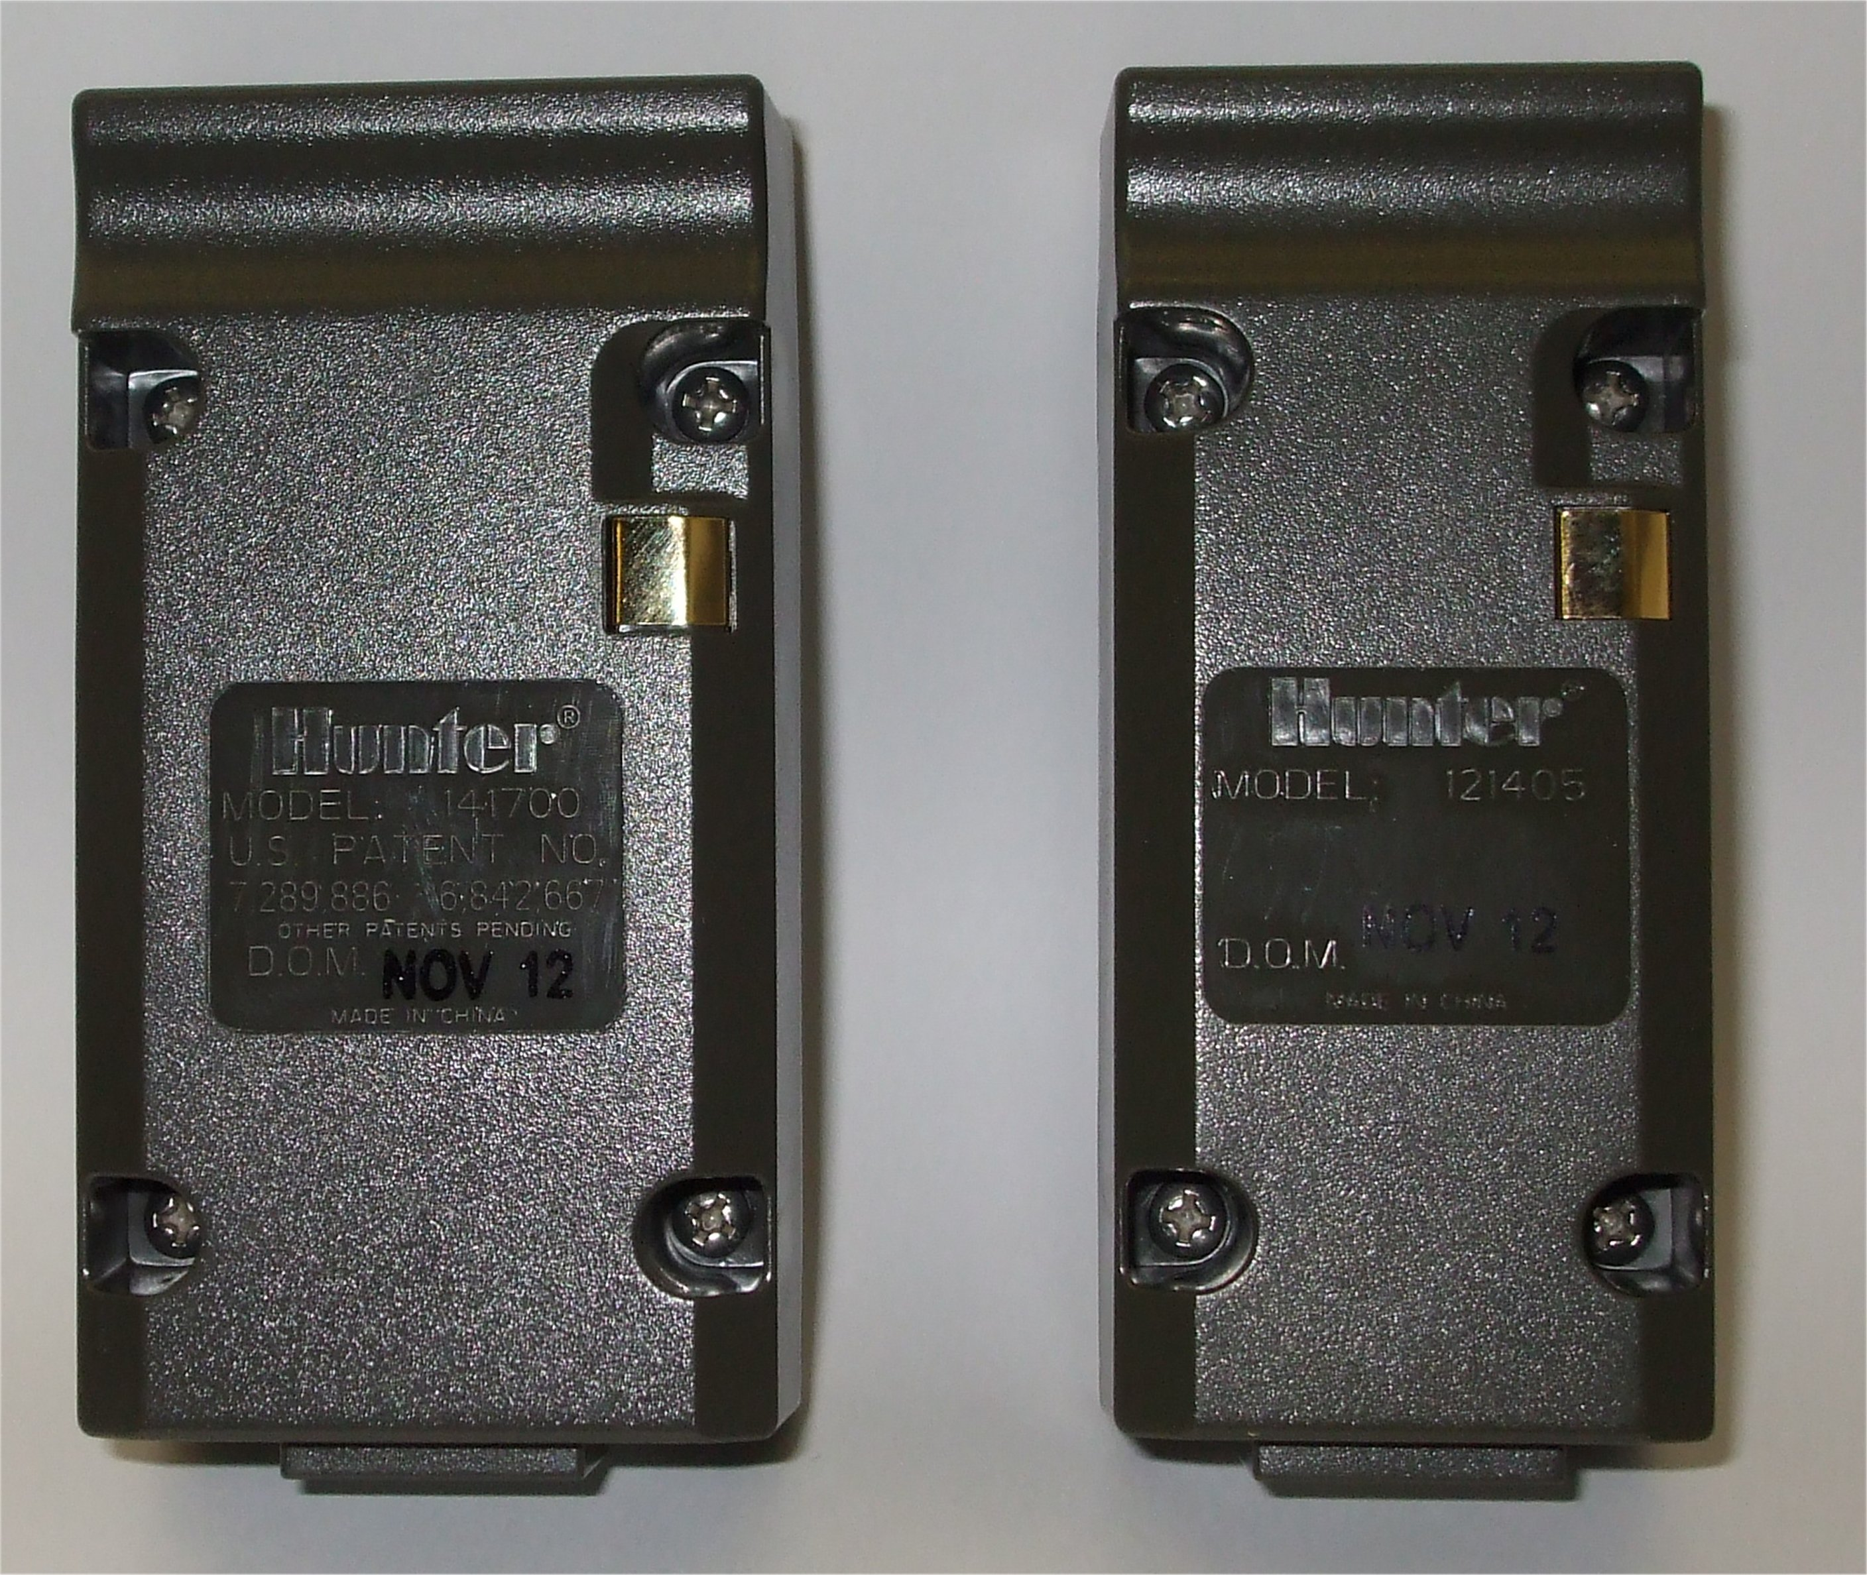
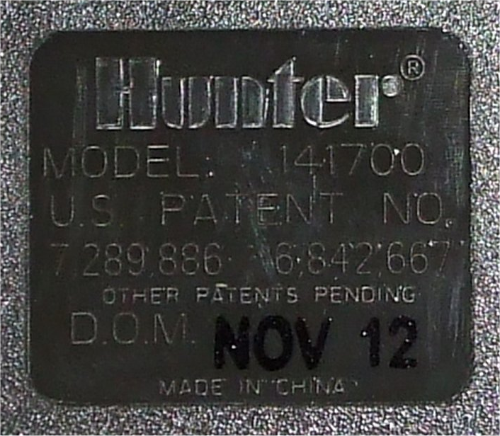
141700
(Metal)
121405
(Plastic)
ICORE Master Modules

Slide 61
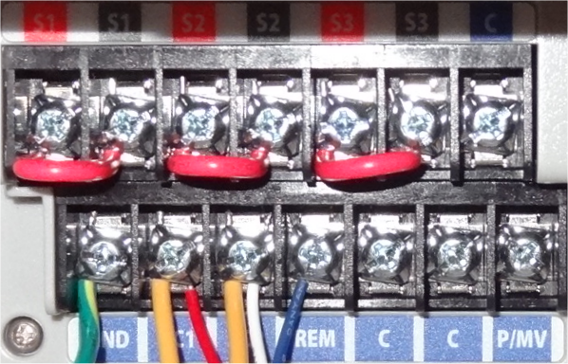
S1
S1
S2
S2
S3
S3
c
GND
AC1
AC2
REM
c
c
P/MV
24 Vac Power Connections
ICORE Controllers

Slide 62
S1
S1
S2
S2
S3
S3
c
GND
AC1
AC2
REM
c
c
P/MV
Clik™ / Flow Sensor Connections
(Normally Closed Circuits)
ICORE Controllers

Slide 63
S1
S1
S2
S2
S3
S3
c
GND
AC1
AC2
REM
c
c
P/MV
Field Commons Connections
ICORE Controllers

Slide 64
S1
S1
S2
S2
S3
S3
c
GND
AC1
AC2
REM
c
c
P/MV
Pump/Master Valve Connections
ICORE Controllers

Slide 65
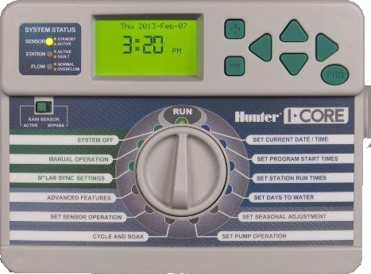
1
2
4
7
0
5

Slide 66
F
I
R
M
W
A
R
E
1.00.XX 24Vac
2.00.10 Decoder/Flow
3.00.XX SolarSync/VFD Pump
(2.00.12)
124705 ~ ICORE Facepack

Slide 67
P
R
O
G
R
A
M
124705 ~ ICORE Facepack

Slide 68
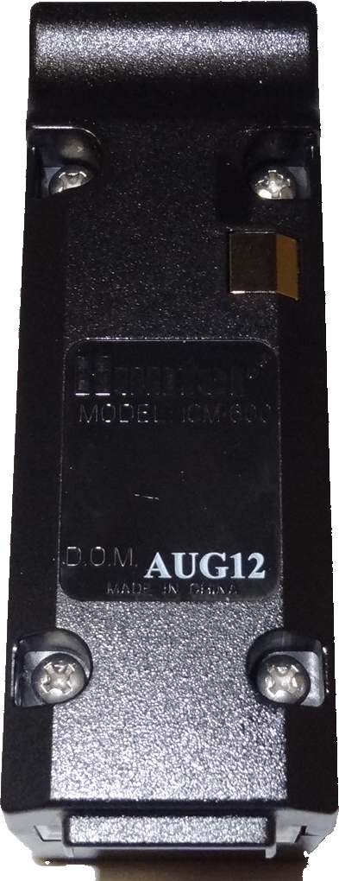
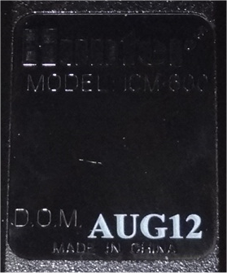
I
C
M
6
0
0
ICORE Station Modules

Slide 69
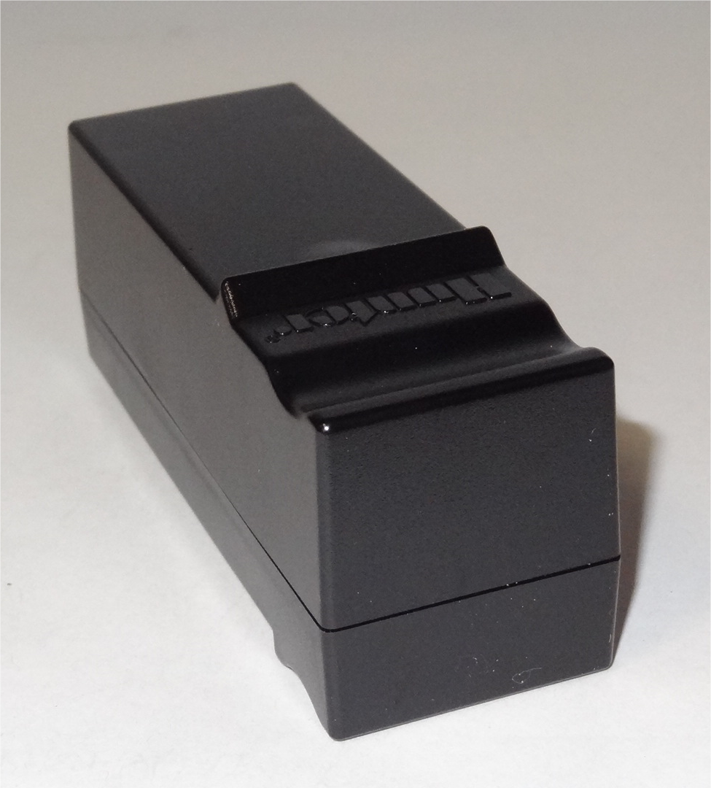
0.56 Amp @ 24Vac
ICORE Station Modules

Slide 70
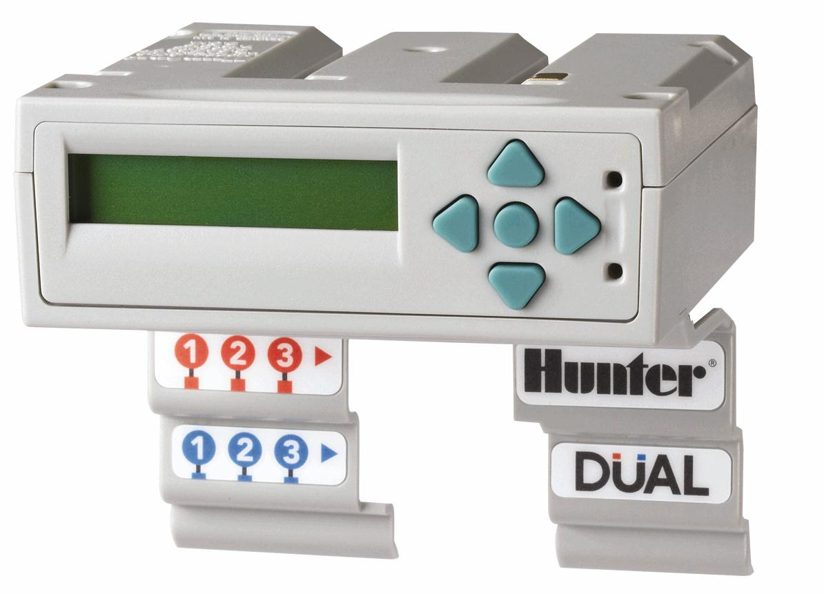
D
U
A
L
DUAL 48 Module

Slide 71
Stations on decoder module
Active station status
Line status indicator
Solenoid chatter
Line amperage indicator (500mA Max.)
DUAL 48 Module

Slide 72
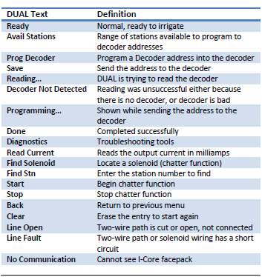
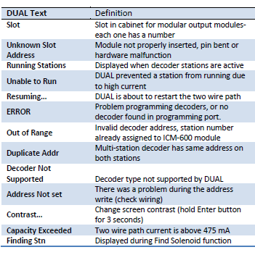
DUAL 48 Module

Slide 73
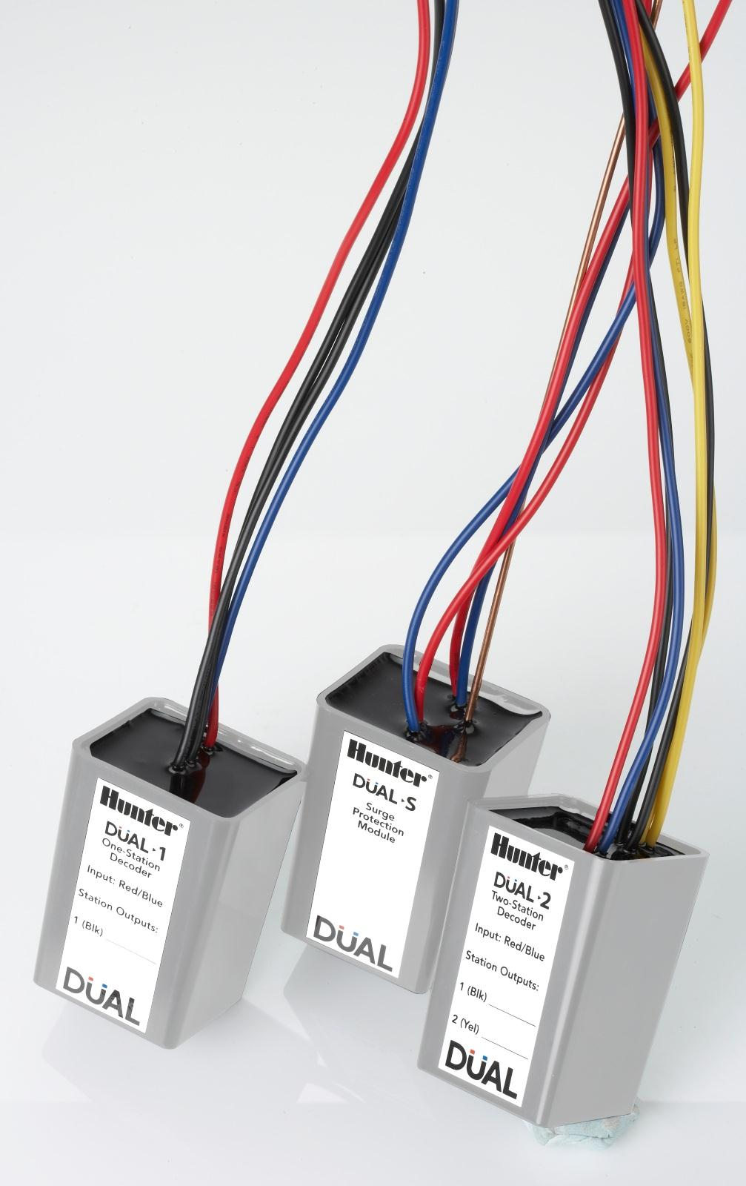
1 station decoder
2 station decoder
Surge decoder
2 solenoids per output
Multiple same station addresses
DUAL 48 Module

Slide 74
Q & A
170

Slide 75
2-Wire Field Components

Slide 76
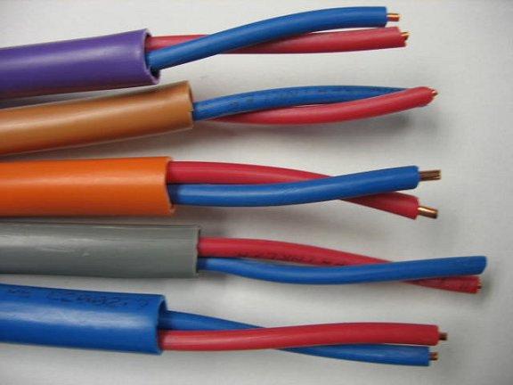
IDWire: Twisted, red/blue, direct burial in flexible colored jacket
Color coding for correct installation & tracing
Jacketed for better protection
Twisted-pair design provides:
Greater surge resistance
Greater tensile strength
Resistance to electrical noise and crosstalk from AC wiring.
IDWIRE: The Magic in the Wire
2-Wire Field Components

Slide 77

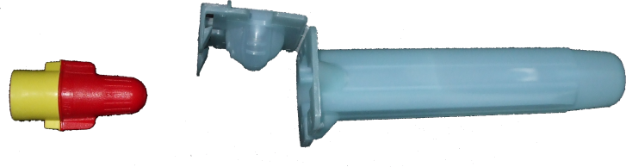
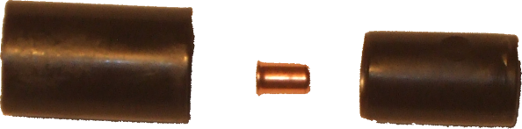
DS-
3M DBY/R-6
Connectors
(2-wire - Decoder)
DS Type
Connectors
(Decoder - Solenoid)
Wire Connectors
2-Wire Field Components

Slide 78
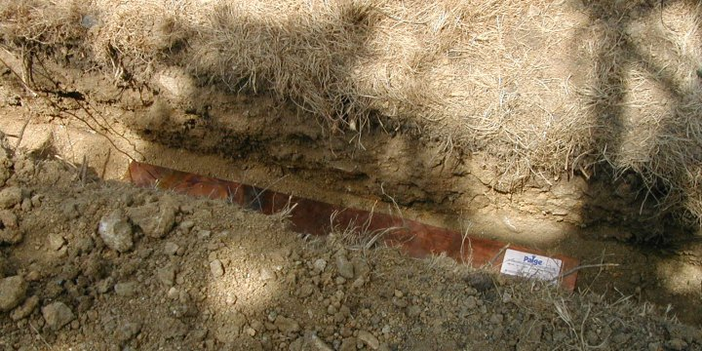
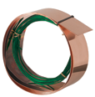
Grounding Plate
4” x 36” / 4” x 96”
10cm X 1m / 10cm x 2.4m
Grounding Plate
Installed
Grounding Plates
2-Wire Field Components

Slide 79
Cadweld
Plus
Power Set TM
Grounding Extras
2-Wire Field Components

Slide 80
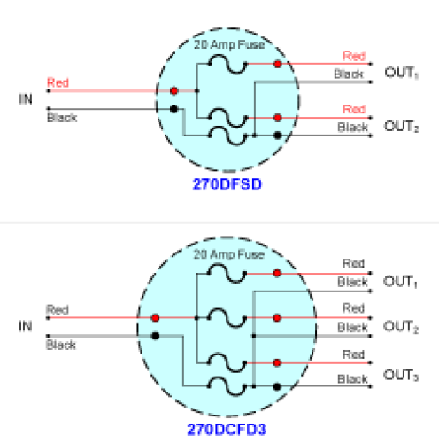
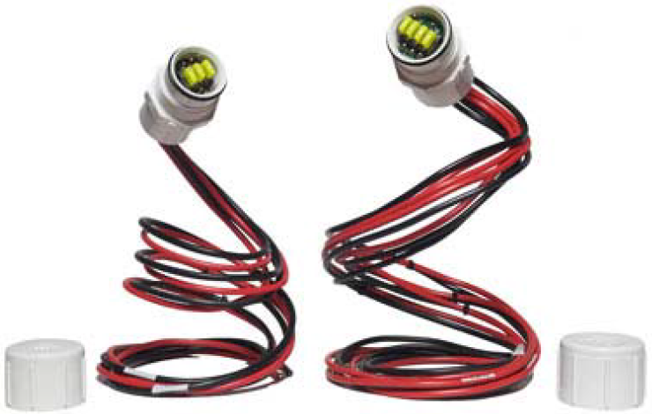
Paige Wire 270DCFD
2-Wire Field Components

Slide 81
Decoder Design

Slide 82
Planning Your 2-wire Paths
P
L
A
N
N
I
N
G

Slide 83
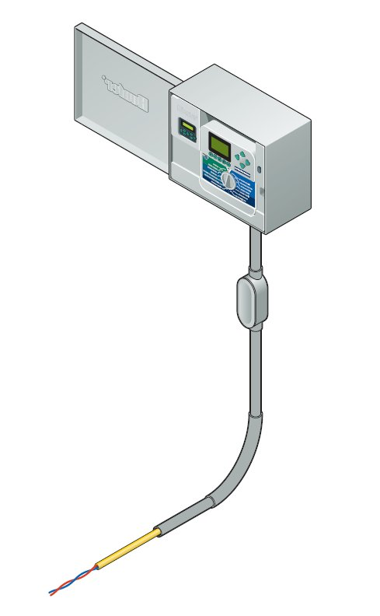
Each 2-wire cable output is called a “path”.
All decoder stations MAY be on a single path. (Not recommended)
There are multiple paths available from the controller.
Use as many paths as you need, to reach all valves efficiently.
Paths are not to be “looped” back to controller, or each other.
Path
Planning your 2-wire paths
Decoder Design

Slide 84
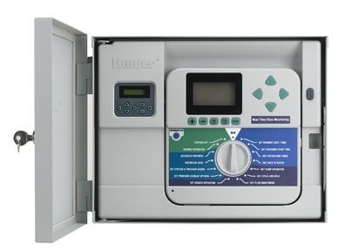

Place a decoder by each 24VAC valve (standard solenoids) (A few solenoids with internal diodes or capacitors may not be decoder compatible, but most are)
Max distance from controller to furthest decoder on each path: (Follow Manufacturer's specs.)
Max distance from decoder to solenoid, 150 ft. (Recommended maximum)
= Decoder
= Earth Ground
Planning your 2-wire paths
Decoder Design

Slide 85
Use a different color cable for each wire path
2-wire paths can be spliced
Follow the splicing rules
Use pipe trenches to route wires
Maximum wire distance applies to each wire path from the controller to the end of each run
= Decoder
= Earth Ground
Planning your 2-wire paths
Decoder Design

Slide 86
Decoder Path Wire Sizing
W
I
R
E
S
I
Z
I
N
G

Slide 87


DUAL 5,000 ft / 1.5 km
DUAL 7,500 ft / 2.25 km
Wire Sizing
Decoder Design

Slide 88
L_{w} =
2 x V_{d} x 1,000
R_{w} x I_{w}
L_{w} = Wire path length in feet or meters
V_{d} = Allowable voltage drop
R_{w} = Resistance per 1,000ft / 1,000m of wire
I_{w} = Maximum current on 2-wire path
Wire Sizing
Decoder Design

Slide 89
V_{d} = Allowable voltage drop
(1.4 x 24) – 20 = 14V
Wire Sizing
Decoder Design

Slide 90

R_{w} = Resistance of wire
Wire Sizing
Decoder Design

Slide 91
I_{w} = Maximum current on 2-wire path
There are two currents to calculate;
Decoders at idle, no solenoids active = 3.5mA (designated by 0.005)
Decoders Active, 1 Hunter solenoid = 45mA (designated by 0.045)
Wire Sizing
Decoder Design

Slide 92

Wire Sizing
Decoder Design

Slide 93
Q & A
170

Slide 94
Decoder Component Installation
I
N
S
T
A
L
L
A
T
I
O
N

Slide 95

3’ Wire Slack for Service
Decoder Component Installation
Decoder Design

Slide 96

Single Station Decoder
Decoder Component Installation
Decoder Design

Slide 97

Multiple Station Decoder
Decoder Component Installation
Decoder Design

Slide 98

Decoder Grounding
Decoder Component Installation
Decoder Design

Slide 100




Slide 102
Decoder Programming at Controller
P
R
O
G
R
A
M
M
I
N
G
ACC
Decoder Programming with ICD-HP

Slide 103
Use the programming port on the ADM99
Do NOT use the same station number on multiple decoders
Multiple station decoders program stations sequentially
Any station decoder can be programmed as a Pump/Master Valve
Sensor decoders can be programmed as a Clik and/or Flow sensor
Sensor decoders programmed for flow use sensor address #5
ACC Decoder Programming at Controller
Decoder Design

Slide 104
F
I
R
M
W
A
R
E
Decoder Programming
(Hands On)
Decoder Programming at Controller
Decoder Design

Slide 105
Can use the power from the 2-wire path or ICD-HP
Do NOT use the same station number on multiple decoders
Multiple station decoders program stations individually
Any station decoder can be programmed as a Pump/Master Valve
Sensor decoders can be programmed as a Clik and/or Flow sensor
Sensor decoders programmed for flow use sensor address #5
Decoder Programming with ICD-HP
Decoder Design

Slide 106
F
I
R
M
W
A
R
E
ICD-HP Programming
(Hands On)
Decoder Programming with ICD-HP
Decoder Design

Slide 107
Decoder Programming at Controller
P
R
O
G
R
A
M
M
I
N
G
DUAL
Decoder Programming with ICD-HP

Slide 108
Use the programming port on the DUAL
Using the same station number on multiple decoders
Multiple station decoders program stations sequentially
Multiple station decoders program stations non-sequentially
NO Pump/Master Valve decoders
NO Sensor decoders on the DUAL system
DUAL Decoder Programming at Controller
Decoder Design

Slide 109
F
I
R
M
W
A
R
E
Decoder Programming
(Hands On)
DUAL Decoder Programming at Controller
Decoder Design

Slide 110
Use the programming port on the DUAL
Using the same station number on multiple decoders
Multiple station decoders program stations sequentially
Multiple station decoders program stations non-sequentially
NO Pump/Master Valve decoders
NO Sensor decoders on the DUAL system
DUAL Decoder Programming at Controller
Decoder Design

Slide 111
F
I
R
M
W
A
R
E
ICD-HP Programming
(Hands On)
DUAL Decoder Programming at Controller
Decoder Design

Slide 112
G
R
O
U
N
D
I
N
G
At the Controller
At the First 2-wire connection
At the End of every 2-wire path
Every 12TH decoder
Every 1,000’ / 300 m
Decoder Design

Slide 113
0
1
0
2
0
3
0
4
0
5
0
6
0
7
0
8
0
9
1
0
1
1
1
2
Every 12TH Decoder /
End of 2-wire Path
Minimum Grounding
Decoder Design

Slide 114
1,000 Feet
300 Meters
0
1
0
2
0
3
0
4
0
5
0
6
0
7
0
8
0
9
1
0
1
1
1
2
First 2-wire
Connection
Minimum Grounding
Decoder Design

Slide 115
1,000 Feet
300 Meters
0
1
0
2
0
3
0
4
0
5
0
6
0
7
0
8
0
9
1
0
1
1
1
2
10 Ohms
Or Less
Minimum Grounding
Decoder Design

Slide 116
0
1
0
2
0
3
0
4
0
5
0
6
0
7
0
8
0
9
1
0
1
1
1
2
Grounding Principle
Decoder Design

Slide 117

0
1
0
2
0
3
0
4
0
5
0
6
0
7
0
8
0
9
1
0
1
1
1
2
Grounding Principle
Decoder Design

Slide 118
Q & A
170

Slide 119
Grounding Installation Details

Slide 120
Grounding Rod
Grounding Rod
2xL
L
Ground Rod sphere of influence
Grounding Installation Details

Slide 121
Grounding Plate
W
3xW
Grounding Plate
L
3xL
Ground Plate sphere of influence
Grounding Installation Details

Slide 122



Up to 64 Stations, Non-rocky soils
Grounding Installation Details

Slide 123


Up to 64 Stations, all soils
Grounding Installation Details

Slide 124


Up to 96 Stations, Non-rocky soils
Grounding Installation Details

Slide 125


Up to 96 Stations, all soils
Grounding Installation Details

Slide 126


Up to 128 Stations, Non-rocky soils
Grounding Installation Details

Slide 127


Up to 128 Stations, all soils
Grounding Installation Details

Slide 128


Up to 256 Stations, all soils
Grounding Installation Details

Slide 129
Q & A
170

Slide 130
ClikTM Sensors

Slide 131


C
L
I
K
S
E
N
S
O
R
ACC
ICORE

Slide 132
F
I
R
M
W
A
R
E
ClikTM Sensor Programming
(Hands On)
ClikTM Sensor

Slide 133
Flow Sensors

Slide 134

F
L
O
W
S
E
N
S
O
R
ACC
ICORE

Slide 135
Flow Sensor
Fitting
FLOW
FLOW
Minimum Distance
10 x Pipe size
Minimum Distance
5 x Pipe size
Flow Sensor Installation

Slide 136
F
I
R
M
W
A
R
E
Flow Sensor Programming
(Hands On)
Flow Sensor

Slide 137
Q & A
170

Slide 138
Troubleshooting Notes

Slide 139
T
R
O
U
B
L
E
S
H
O
O
T
I
N
G
Wire Size Calculation
Wire Resistance
Component Amperages
Tools

Slide 140
T
O
O
L
S
Pro93 V.O.M.
Misc. hand tools
Test solenoid
Wire Tracker
Ground Fault Locator
Troubleshooting Tools

Slide 141
F
I
R
M
W
A
R
E
Pro93 V.O.M.
(Hands On)
Troubleshooting Tools

Slide 142
Q & A
170

Slide 143

24VAC Controller
120VAC
24-26VAC
(60Hz)
(60Hz)
24Vac Vs Decoder

Slide 144
1/60 Second
+26 Volts
0 Volts
-26 Volts
60Hz
(Hertz is equivalent to cycles per second)
24Vac Sine Wave
24Vac Vs Decoder

Slide 145

24Vac Sine Wave
24Vac Vs Decoder

Slide 146
Controller
Valves
Wiring
24Vac Vs Decoder

Slide 147
Decoder Controller
120VAC
30-35VDC (+/- pulsing)
(60Hz)
(1 – 2 Hz)
24Vac Vs Decoder

Slide 148
1 Second
+38 Volts
0 Volts
-38 Volts
1Hz
(Hertz is equivalent to cycles per second)
Square Wave
24Vac Vs Decoder

Slide 149
1 Second
+38 Volts
0 Volts
-38 Volts
Data Signal
Square Wave
24Vac Vs Decoder

Slide 150

Square Wave
24Vac Vs Decoder

Slide 151
Controller
Valves
Data Signals
Pulsing 30-38Volts
Wiring
Decoders
Grounding
24Vac Vs Decoder

Slide 152
Constantly “HOT”
and pulsing
30-38V
1Hz
11VAC – 13VAC
500Hz
D
E
C
O
D
E
R
24Vac Vs Decoder

Slide 153

Decoder to Solenoid
24Vac Vs Decoder

Slide 154
Fluke 117 Voltmeter
Extech Clamp On mA meter
T
O
O
L
S
Armada Clamp On mA meter
ICD-HP
Misc. hand tools
24Vac/60Hz power source
Test decoder/solenoid
Armada Wire Tracker
Armada Ground Fault Locator
Troubleshooting Tools

Slide 155





FLUKE 117 Voltmeter
Troubleshooting Tools

Slide 156



Extech 380942
Troubleshooting Tools

Slide 157




Armada Pro93
Troubleshooting Tools

Slide 158

Hunter ICD-HP Features
Decoder Programming
Decoder Firmware
Diagnostics
Station Test
Clik/Flow Sensor Test
Volt / Amp Meter
Hunter ICD-HP
Troubleshooting Tools

Slide 159




Miscellaneous Tools
Troubleshooting Tools

Slide 160

24Vac, 60Hz power source
Troubleshooting Tools

Slide 161

Test Decoder/solenoid
Troubleshooting Tools

Slide 162

Pro300 Tracker
Diagnostic Tools

Slide 163

GFL3000 Ground Fault Locator
Troubleshooting Tools

Slide 164


Extech 382153
Troubleshooting Tools

Slide 165
DS-
3M DBY/R-6
Connectors
(2-wire - Decoder)
DS Type
Connectors
(Decoder - Solenoid)
Wire Connectors
Troubleshooting Tools

Slide 166
S
Y
S
T
E
M
C
O
M
P
O
N
E
N
T
S
Controller
2-Wire Path
Decoder
Solenoid
System Diagnostics

Slide 167
Controller
Field Wiring (2-wire path)
Decoder
Solenoid
System Diagnostics

Slide 168
What are the alarms or fault indicators?
Controller related?
2-wire related?
Decoder related?
Solenoid related?
System Diagnostics

Slide 169
C
O
N
T
R
O
L
L
E
R
Controller
2-Wire Path
Decoder
Solenoid
System Diagnostics

Slide 170
Check programming !
Check the decoder set-up!
Check sensor set-up !
Check the LED indicators on the ADM.
Check the LED indicators on the Master Module
Check the 2-wire path voltage at the controller
Check the controller using a test decoder/solenoid.
Controller
System Diagnostics

Slide 171
MV1/MV2 LEDs continuously cycle;
No station/decoder modules installed
Station module
Master module
Face pack
No status light on the ADM (2-wire path);
Power bar in the “OFF” position
Decoder module
Master module
Transformer fuse continuously blows;
High voltage wire shorting out (120/230)
Decoder module (2-wire path)
Master module
Controller
System Diagnostics

Slide 172

Using a Fluke 117
System Diagnostics

Slide 173

Using a ICD-HP
System Diagnostics

Slide 174

Using a test decoder/solenoid
System Diagnostics

Slide 175
2
W
I
R
E
P
A
T
H
Controller
2-Wire Path
Decoder
Solenoid
System Diagnostics

Slide 176
Check 2-wire Resistance.
Resistance should be 600,000 ohms or greater.
Check 2-wire Voltage.
Voltages should be 20V – 35V
(Using the controller voltage)
Wire splices must be done with the manufacturer’s specified connectors (3M, DBY/R-6 on 2-wire path)
Trace out the 2-wire path (Pro300 Tracker)
Check the 2-wire path for a leak to ground (GFL3000)
2-wire Path
System Diagnostics

Slide 177

Good connector in the wrong application !
DS Type
Connectors
(wrong application)
2-wire Path
System Diagnostics

Slide 178



2-wire Path
System Diagnostics

Slide 179
Q & A
170

Slide 180
Diagnostic Method
2
W
I
R
E
P
A
T
H

Slide 181
Half Method;
Test at the controller
Test at the first connection from the controller
Test at the next connection or “Half” way down the 2-wire path
Test at the next connection or “Half” way down the 2-wire path
Continue this until you have pin-pointed the damaged area/component
2-wire Path
System Diagnostics

Slide 182
Overload / Resistance
2
W
I
R
E
P
A
T
H

Slide 183
2-wire path shorted (ADM Overload);
RESISTANCE !!!
Test at the controller
Test at the first connection from the controller
Test at the next connection or “Half” way down the 2-wire path
Test at the next connection or “Half” way down the 2-wire path, towards the short
Continue this until you have pin-pointed the damaged area/component
2-wire Path
System Diagnostics

Slide 184
600,000+ Ohms
600,000+ Ohms
600,000+ Ohms
37 Ohms
Remove all 2-wire
paths from the
ADM99 and check
resistance on the
2-wire paths
2-wire Path – Half Method
System Diagnostics

Slide 185
Break 2-wire path
at first connection
2-wire Path – Half Method
System Diagnostics

Slide 186
600K+ Ohms
Re-check the
resistance of the
2-wire path.
2-wire Path – Half Method
System Diagnostics

Slide 187
600K+ 0hms
37 Ohms
Problem Direction
Check resistance
here both pairs,
mark controller side
wires
2-wire Path – Half Method
System Diagnostics

Slide 188


Resistance on the 2-wire path
2-wire Path – Half Method
System Diagnostics

Slide 189
600K+ Ohms
Break 2-wire path
at connection
2-wire Path – Half Method
System Diagnostics

Slide 190
600K+ Ohms
600K+ Ohms
Check resistance
here on the “field”
side wires
2-wire Path – Half Method
System Diagnostics

Slide 191
600K+ Ohms
Twist the Red/Blue
“field” side wires
together
2-wire Path – Half Method
System Diagnostics

Slide 192
1-3 Ohms
37 Ohms
Problem Direction
600K+ Ohms
Check resistance
here on all wires
2-wire Path – Half Method
System Diagnostics

Slide 193
Untwist Red/Blue
wires and reconnect
paths together
2-wire Path – Half Method
System Diagnostics

Slide 194
Half way point or
Next 2-wire spice
600K+ Ohms
37 Ohms
600K+ Ohms
Break 2-wire path
at connection
2-wire Path – Half Method
System Diagnostics

Slide 195
37 Ohms
Check resistance
here on the “field”
side wires
2-wire Path – Half Method
System Diagnostics

Slide 196
600K+ Ohms
37 Ohms
37 Ohms
Check resistance
here on the
2-wire paths
2-wire Path – Half Method
System Diagnostics

Slide 197
600K+ Ohms
37 Ohms
37 Ohms
Twist the Red/Blue
“field” side wires
together
2-wire Path – Half Method
System Diagnostics

Slide 198
1-3 Ohms
37 Ohms
1-3 Ohms
600K+ Ohms
37 Ohms
Check resistance
here on the
2-wire paths
2-wire Path – Half Method
System Diagnostics

Slide 199
Q & A
170

Slide 200
Voltage
2
W
I
R
E
P
A
T
H

Slide 201
2-wire path damaged;
VOLTAGE !!!
Test the voltage at the controller/ADM99
Test at the first connection from the controller
Test at the next connection or “Half” way down the 2-wire path
Test at the next connection or “Half” way down the 2-wire path
Continue this until you have pin-pointed the damaged area/component
System Diagnostics

Slide 202
33.54Volts
Check the
voltage of the
2-wire path.
2-wire Path – Half Method
System Diagnostics

Slide 203
33.54Volts
Check the
voltage of the
2-wire path.
2-wire Path – Half Method
System Diagnostics

Slide 204
33.54Volts
Check the
voltage of the
2-wire path.
2-wire Path – Half Method
System Diagnostics

Slide 205
Half way point or
Next 2-wire spice
0 Volts
Check the
voltage of the
2-wire path.
2-wire Path – Half Method
System Diagnostics

Slide 206
33.54Volts
0 Volts
Check the
voltage of the
2-wire path.
2-wire Path – Half Method
System Diagnostics

Slide 207
33.54Volts
0 Volts
Damaged
Area
Check the
voltage of the
2-wire path.
2-wire Path – Half Method
System Diagnostics

Slide 208


Voltage 2-wire path
2-wire Path
System Diagnostics

Slide 209


Voltage 2-wire path (field side)
2-wire Path
System Diagnostics

Slide 210


Voltage 2-wire path (controller side)
2-wire Path
System Diagnostics

Slide 211
Q & A
170

Slide 212
Amperage
2
W
I
R
E
P
A
T
H

Slide 213


Amperage 2-wire path (controller power)
2-wire Path
System Diagnostics

Slide 214

Connecting the 24Vac power source
2-wire Path

Slide 215


Using a Extech 380942 with 24Vac power
2-wire Path
System Diagnostics

Slide 216


NO VOLTAGE !!
Using a Extech 380942 with 24Vac power
2-wire Path
System Diagnostics

Slide 217
217mA
24Vac
Power
Supply
1
2
3
4
5
6
7
8
9
10
11
12
13
14
108.5mA
28
27
26
25
24
23
22
21
20
19
18
17
16
15
54mA
Each decoder (7.75mA @ 24Vac)
2-wire Path
System Diagnostics

Slide 218
217mA
194mA
47mA
7.75mA
24Vac
Power
Supply
1
2
3
4
5
6
7
8
9
10
11
12
13
14
16
54mA
23
47mA
17
24
15
18
25
19
20
21
26
27
22
28
2-wire Path
System Diagnostics

Slide 219
24Vac
Power
Supply
1
2
3
4
5
6
7
8
9
10
11
12
13
14
16
23
17
24
15
18
25
19
20
21
26
27
22
28
2-wire Path
System Diagnostics

Slide 220
Q & A
170

Slide 221
D
E
C
O
D
E
R
Controller
2-Wire Path
Decoder
Solenoid
System Diagnostics

Slide 222
Decoder Diagnostics;
Check the wire connections on the suspect decoder
Check the temperature of the suspect decoder
Activate the decoder/solenoid with the ICD-HP
Check the decoder amperage draw (7.75mA at 24Vac)
Check and confirm that the decoder address is correct in the controller
Install your test decoder
Activate test decoder from the controller
Decoder
System Diagnostics

Slide 223
S
O
L
E
N
O
I
D
Controller
2-Wire Path
Decoder
Solenoid
System Diagnostics

Slide 224
Solenoid Diagnostics;
Check the wire connections on the suspect solenoid.
Check the solenoid amperage (45mA)
Check and confirm that the decoder address is correct in the controller !
Activate decoder/solenoid with a ICD-HP
Install a new solenoid.
Activate decoder/solenoid from the controller.
Solenoid
System Diagnostics

Slide 225
Q & A
170

Slide 226
Test

