Slide 1
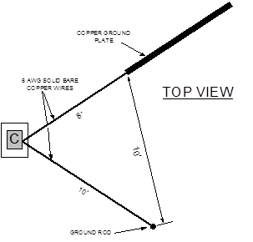
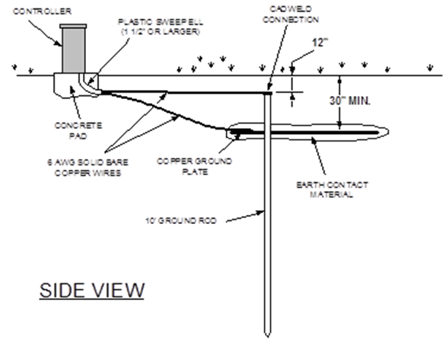
Grounding

Slide 2
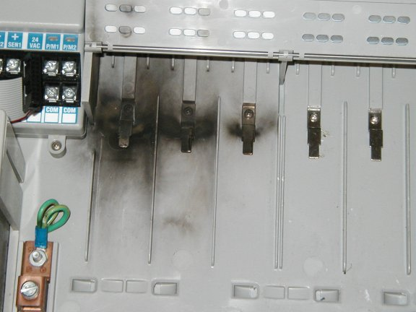
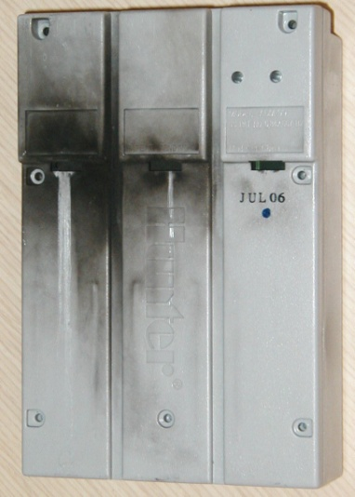
Lightning will occur, Be Prepared!
Face Pack still running, 0 decoders lost.
Surge suppression works great.
Installations have been highly successful.
ACC MUST also be grounded !!!!!!
Remember Decoder Systems have LESS wire in
the ground!!!!!
Less Copper = Less attraction
to lightning!

Slide 3
Grounding Principles
Why Ground?
Lightning / Surge Protection
Dissipates excess voltage and protects components
Electrical Interference
AC Voltage and DC Voltage don’t like each other !

Slide 4
Grounding Principles
How do we ground?
Grounding Rods
Copper rod vertically installed, Cadwell connection
Grounding Plates
Horizontal flat copper plate, contact material

Slide 5
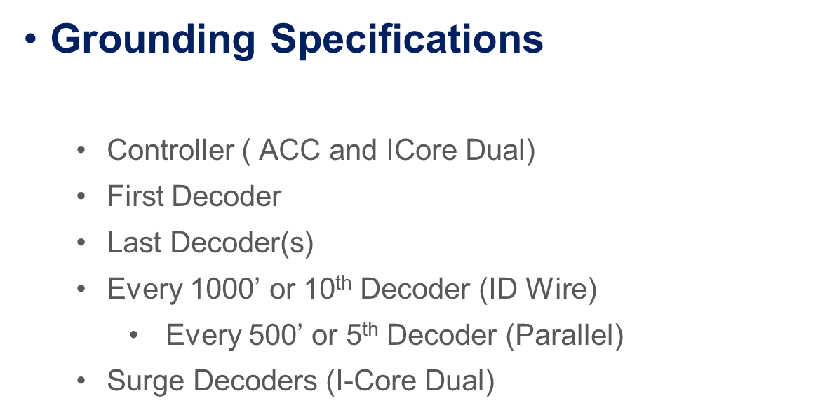

Slide 6
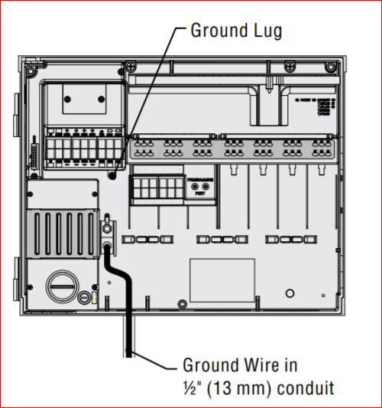
ACC Ground
The ACC features a copper earth ground lug, to the immediate right of the transformer assembly. This earth ground connection is isolated from the primary AC power and is used to ground incoming surges from the communications and output valve wires.
The green or bare copper safety ground is not required with this UL listed floating ground, double-insulated transformer.

Slide 7
Controller Ground Installation
Use 6AWG Bare Copper Wire From Controller to Grounding Rod in Smooth Sweeping Turns
8’ Grounding Rod and a 4”x96” Grounding Plate Minimum
Perpendicular to Wire Run
Ground Wire Should Not Be in the Same Sleeve as Your Power or 2 Wire
8’ Away From Controller in an Irrigated Area
Do Not Cut Grounding Rods
ASIC.org
paigewire.com/grounding.htm

Slide 9
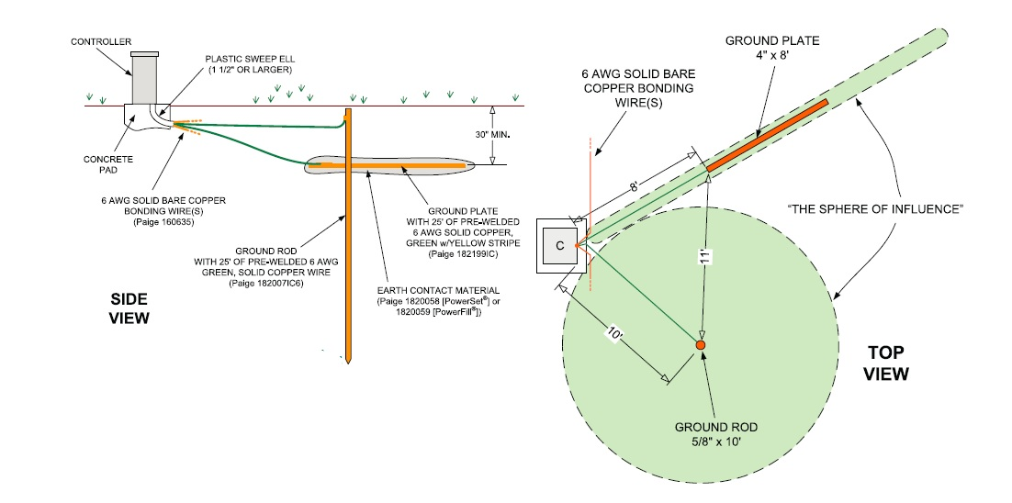
Controller Grounding

Slide 12
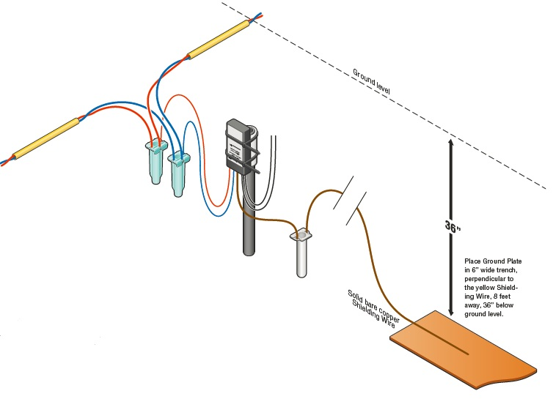
Decoder Grounding

Slide 13
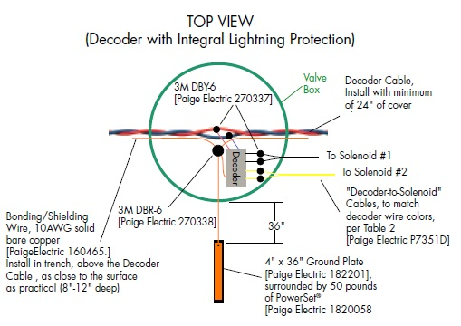
Detail

Slide 14

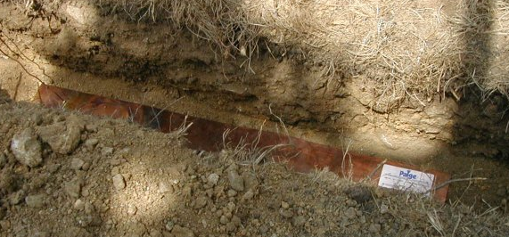
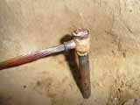
Installation of Ground Plate and Ground Rod
Cadweld Advantages
No maintenance after install
No Turns in Direction (less Resistance)
Decrease Ohms in Grounding Systems

