Slide 1
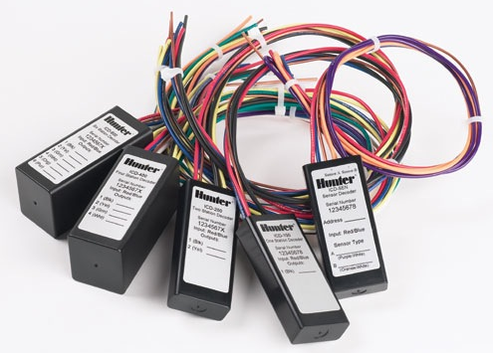
Advanced Decoder Systems

Slide 2
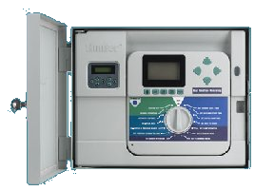
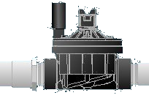
Agenda
Flash ACC
Flash ICD-HP
Update Decoders
Two-Wire Errors
Advanced Two-wire

Slide 3
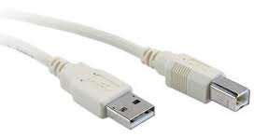
Flashing an ACC Controller
Flashing is basically updating firmware, or the hardware of the controller.
Why Flash?
Updates the controller with the latest functions.
Adds newer features.
Fixes compatibility problems with newer software.
It is free.
Whats needed?
A computer running Windows with a USB port.
Latest firmware update from www.hunterindustries.com
USB cable - usb A to usb B
ACC Facepack

Slide 4
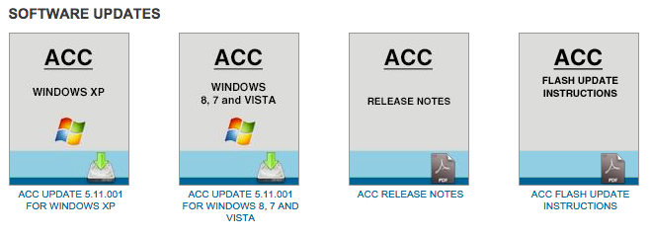
Flashing an ACC Controller
Download new firmware
http://www.hunterindustries.com/irrigation-product/controllers/acc

Slide 5
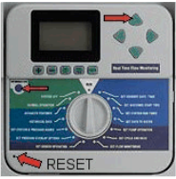
Flashing an ACC Controller
Flashing the Facepack:
1. Do not start the bootloader software until these steps are completed in order! If it was already
running, close it.
2. Make an Easy Retrieve backup at the controller, if desired (dial in Run position, press Information and Program buttons at the same time, follow on-screen instructions). Versions 2.00.25 or later will have the Easy Retrieve backup preserved after flashing. Earlier versions will lose all information, and will have to be re-programmed to irrigate.
3. Connect the computer to the facepack with the cable.
4. See if the facepack is recognized by the computer. Wait until the display on the controller turns on. The backlight will not turn on, but text should appear (may take a minute).
5. When the display appears, you are ready to put the facepack in the flash mode.
6. Press and hold the Up arrow button and the blue Information button, at the same time.
7. Use the pen to momentarily press and release the Reset button,
in the lower left corner of the facepack, while you continue to hold the buttons down.
8. The controller display should disappear. Release the buttons. The facepack is now ready.

Slide 6
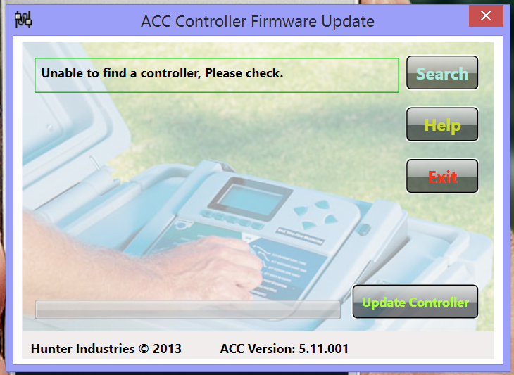
Flashing an ACC Controller
8. Double-click the ACC Bootloader program on the computer to start it, and it should open.
9. At the top you should see a message that the controller was found. If not, click on search.
10. Click on Update Controller.
Should take about 3 - 5 minutes to update

Slide 7
Flashing an ACC Controller
11. After it is complete, you can disconnect the facepack.
12. Reset all facepack data before reinstalling in the controller. This will get rid of any "old" data that may not fit the new operating system.
13. To Reset, reapply power to the facepack. You can reconnect the USB, install a 9 VDC battery, or just install it back into the controller.
14. Press the Program button and hold it down.
15. Press and release the Reset button again (while holding the Program button) and continue to hold it for about 5 seconds, until the Reset menu appears.
16. Use the Down arrow button to move down to the last selection, Reset All Data, and press the + button to erase.
17. It will ask you if you are sure. Press + again to continue. In a few seconds the display will show All Data Erased.
The entire facepack is now updated and reset, and ready to be replaced in the controller.
To restore the Easy Retrieve, place dial in Run position, and press Information and Programs buttons at the same time. Restore will appear as a menu selection (only if a backup was made in the first place). Use the Down arrow to select Restore and press the + button.

Slide 8
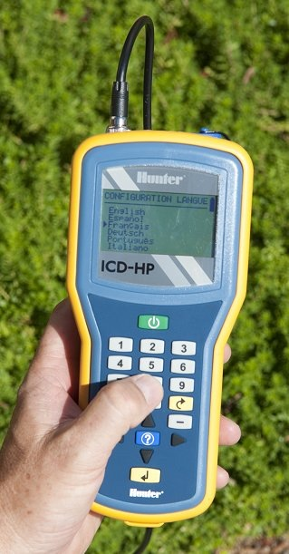
Flashing an ICD-HP

Slide 9
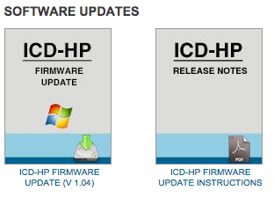
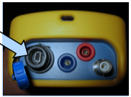
Flashing an ICD-HP
Download new firmware
Use supplied USB cable
Update ICD-HP
http://www.hunterindustries.com/irrigation-product/controllers/icd-hp

Slide 10
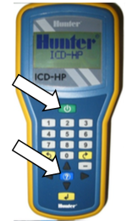
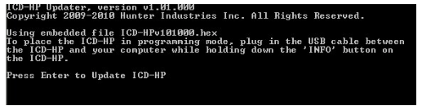
Flashing an ICD-HP
Place the ICD-HP into Flash Mode
Click setup.exe to run ICD-HP updater

Slide 11
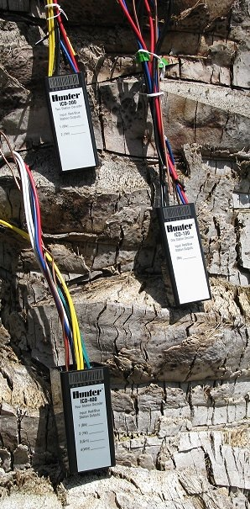
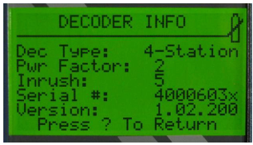
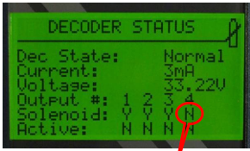
Flashing a Decoder
Why update a decoder?

Slide 12
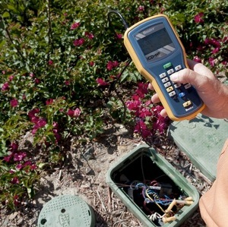
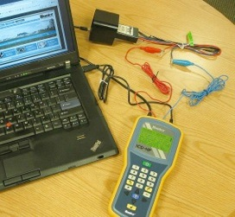
Flashing a Decoder
You will need an ICD-HP with version 1.03 or 1.04 installed.
Decoders can be updated either in the field or on the bench.

Slide 13
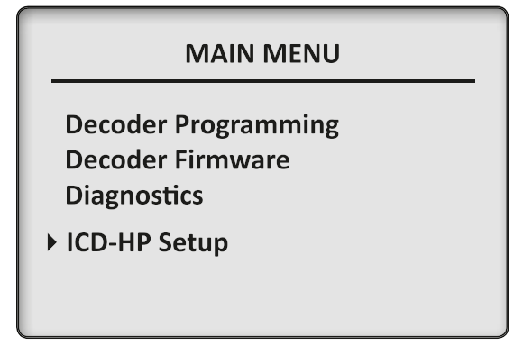
Flashing a Decoder
ICD-HP
The decoder firmware menu checks and has the ability to update a decoder’s
operating system (firmware). Updating will take approximately 2.5 minutes,
and must not be interrupted once it has begun.

Slide 14
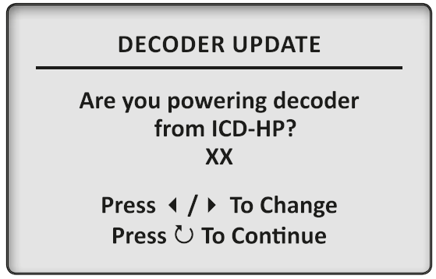
Flashing a Decoder
If updating on the bench, then ‘YES’
If updating in the field, then ‘NO’

Slide 15
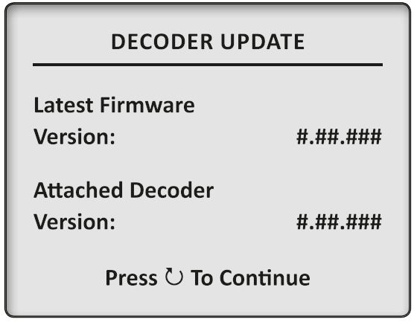
Flashing a Decoder
Will show Latest Firmware - This is what is installed in the ICD-HP

Slide 16
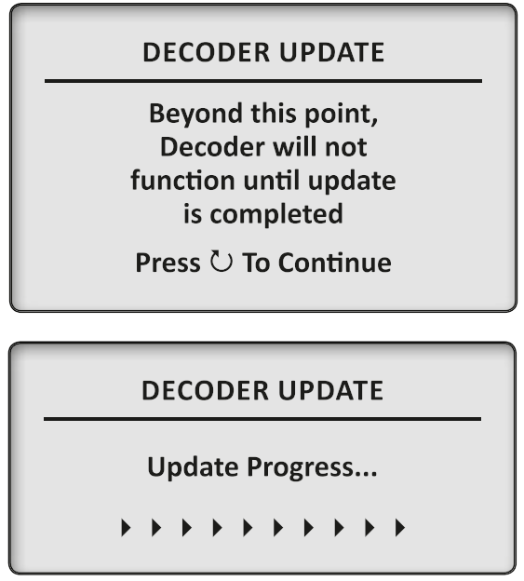
Flashing a Decoder
Update

Slide 17
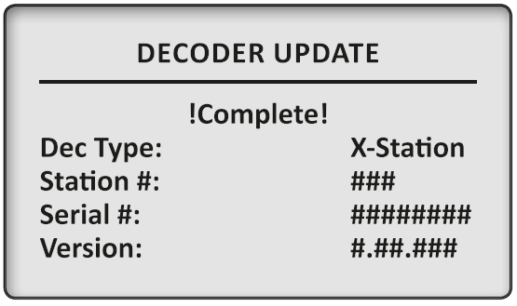
Flashing a Decoder
It will take approximately 2.5 minutes to update a decoder’s firmware.
Do not disconnect the decoder during this update! The firmware update should always be allowed to complete, once it has begun. If the update is interrupted, exit and restart the “Update Dec Firmware” function.Done

Slide 18
Flashing a Decoder
The update will not erase the decoder output station addresses.
If the decoder is used as a Pump, this information will also be retained.
If the decoder is a Sensor Decoder, it will automatically receive the Sensor Decoder firmware, and the address and port settings will be retained.

Slide 19
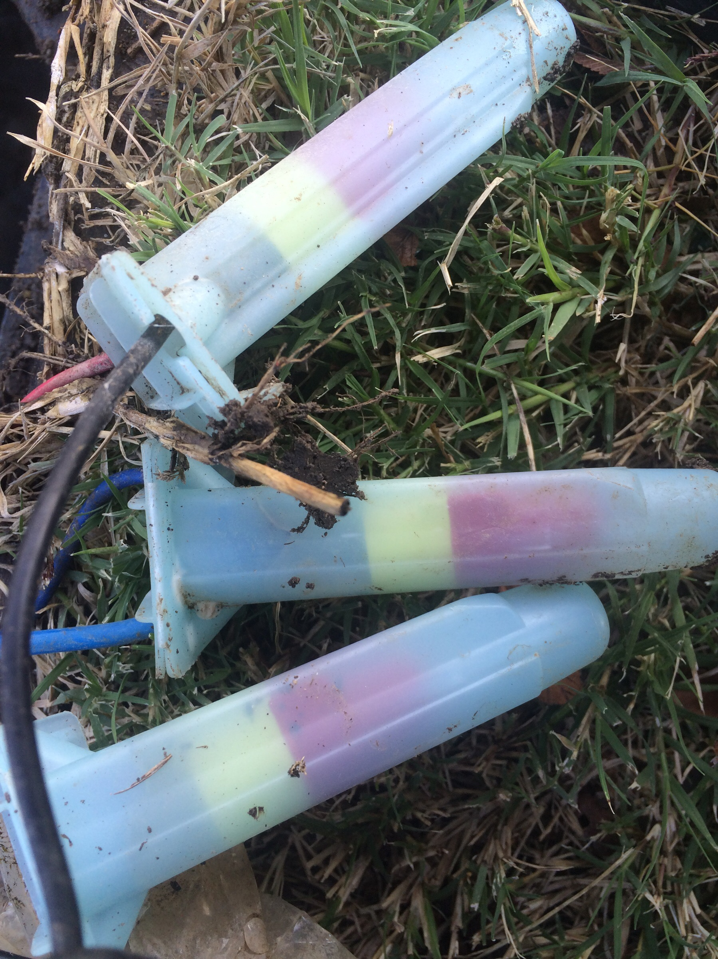
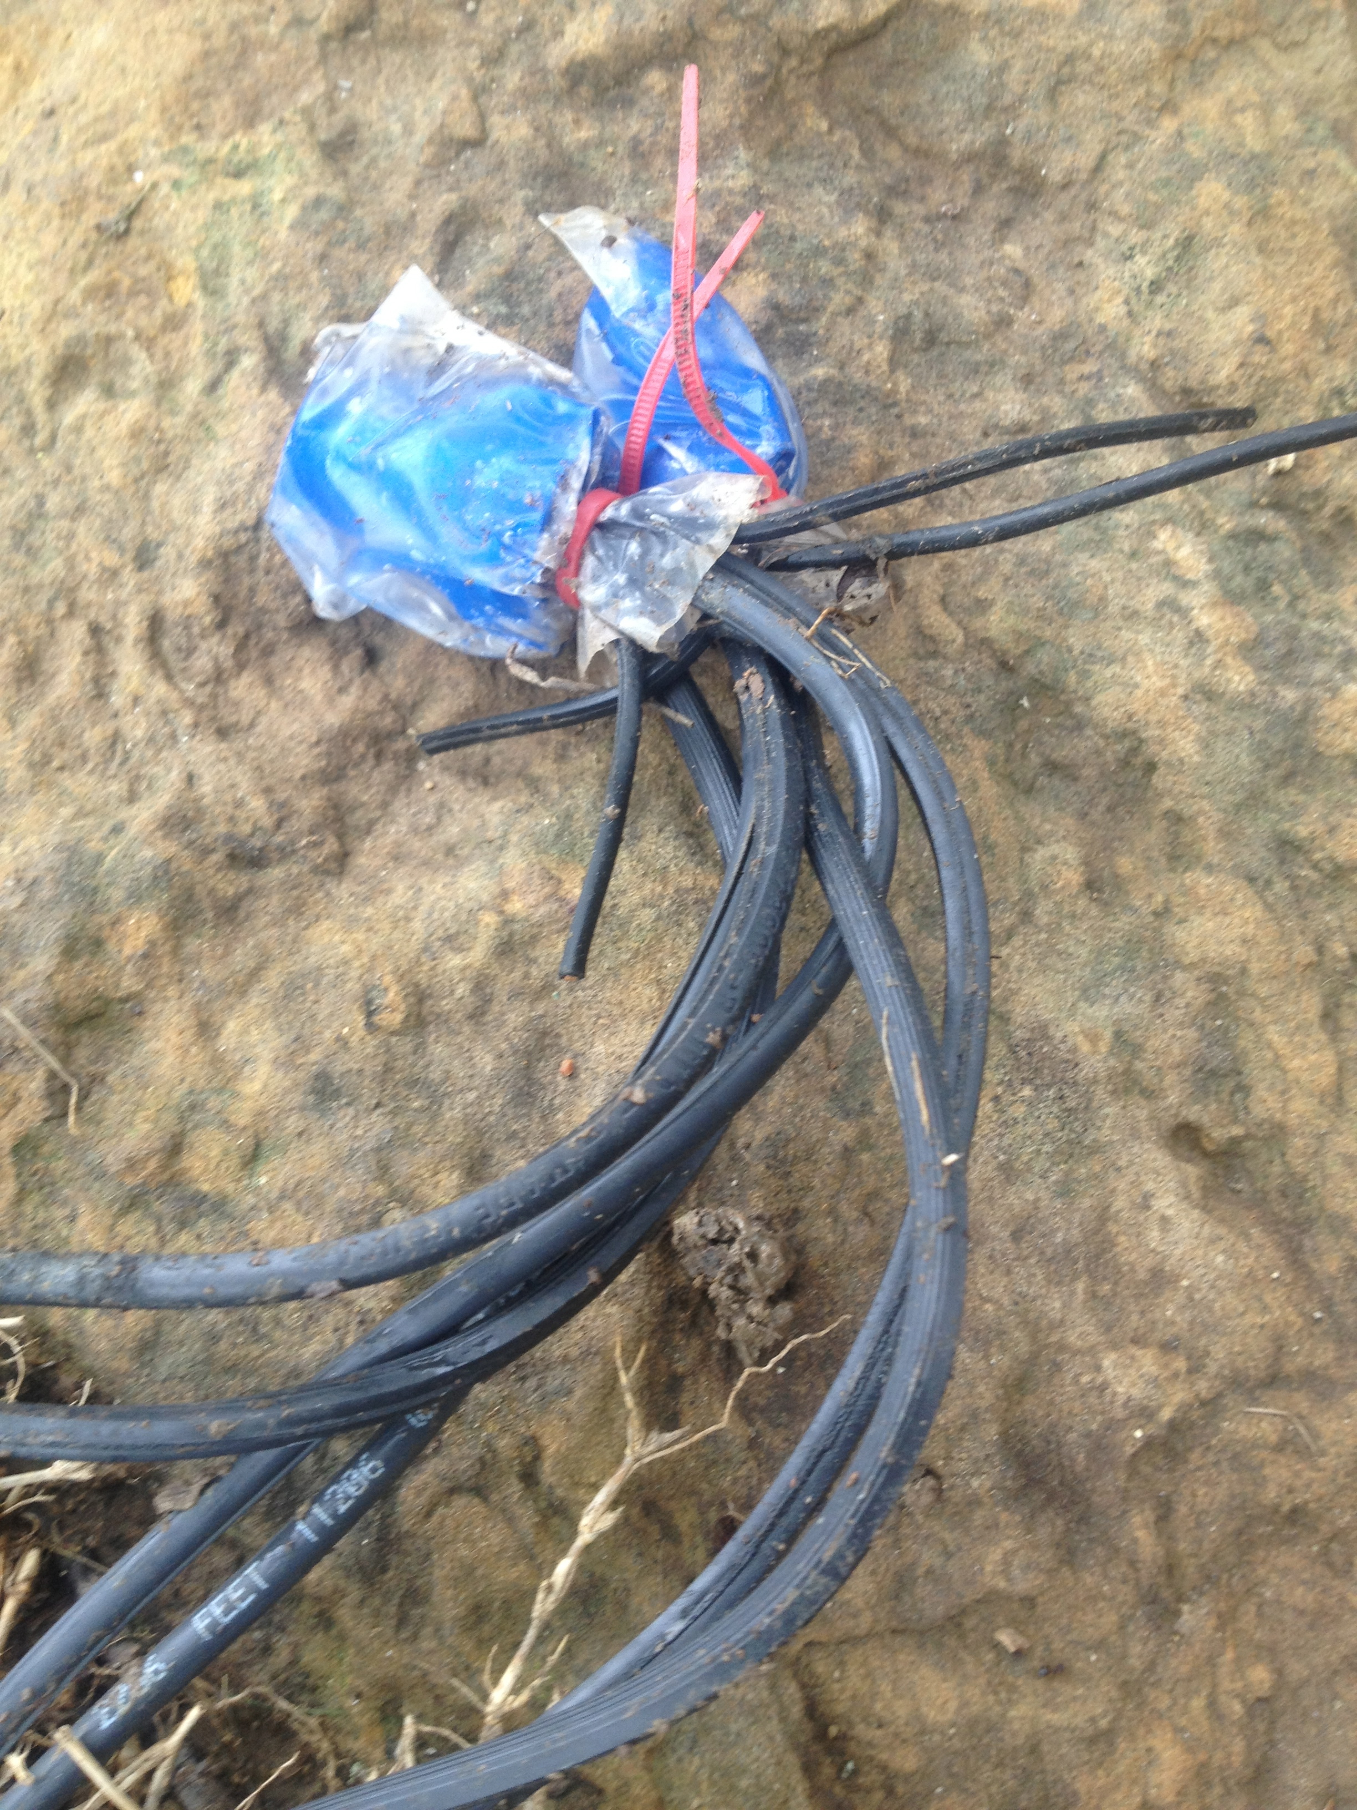
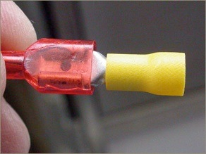
2 Wire Errors
Something has gone wrong!!

Slide 20
Controller Diagnostics
Check List
Power / Main Module plugged in completely
ADM Module plugged in completely
Screw Terminals tight
Sensor Bypass switch activated
Sensor jumper installed
Quick disconnect ribbons damaged
Quick disconnect ribbon pins damaged

Slide 21
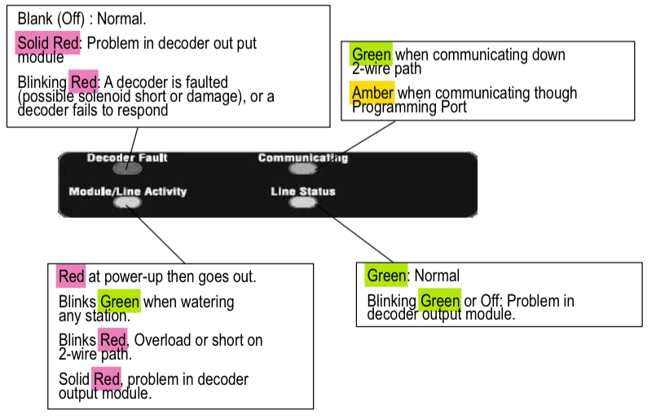
Controller Diagnostics
ADM

Slide 22
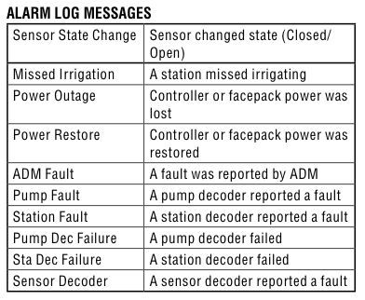
Controller Diagnostics
Alarm Logs
Turn dial to Data History
Arrow down to Alarm Logs

Slide 23
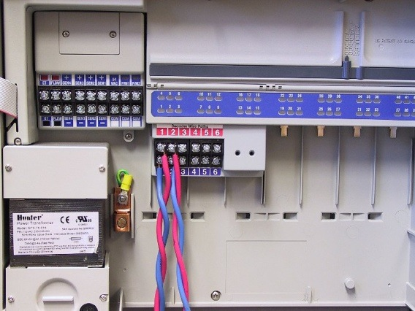
Controller Diagnostics
Controller Working?
Remove 2 wire path and connect known good decoder.
Station 01
HUNTER
24VAC SOLENOID
MADE IN USA

Slide 24
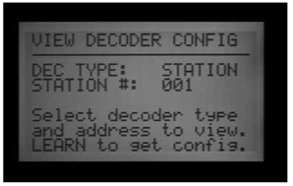
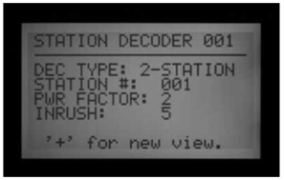
Controller Diagnostics
Turn dial to Advanced Features
Decoder Functions
View Decoder Config
Choose station 01
Press learn
If controller finds station 01 then controller is functioning.

Slide 25

Field Troubleshooting
50 - 50 method
Clamp Meter Method

Slide 26
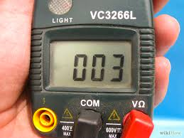
Wire Path
Resistance of 2 wire path should be 600k ohms or greater
Resistance from red or blue to ground should be 1meg or greater
There should be no voltage from red or blue to ground.
If there is a .4vdc or greater voltage, the wire has a ground fault and may interrupt communications to the decoders

Slide 27
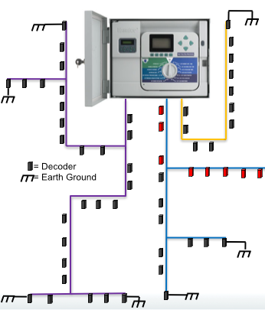

Field Troubleshooting
50 - 50

Slide 28
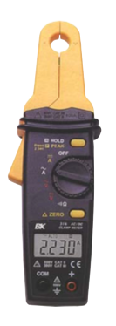
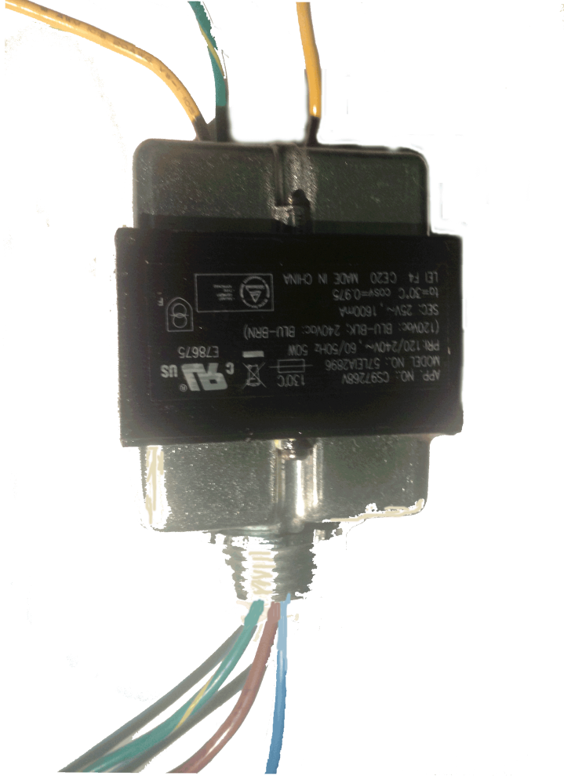
Field Troubleshooting
Clamp Meter Method
Milli-Amp Clamp Meter
24vac transformer
24vac solenoid
Power for transformer

Slide 29
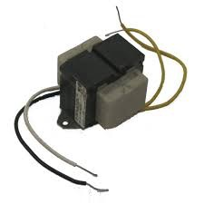
Field Troubleshooting
Check for short to ground.
Remove wire paths from controller
Power 2 wire path with transformer and solenoid for protection.
Connect Both red and blue wires to solenoid
Other side of transformer to Ground
Connect to earth ground
HUNTER
24VAC SOLENOID
MADE IN USA

Slide 30
Field Troubleshooting
Check for short to ground.
Remove wire paths from controller
Power 2 wire path with transformer and solenoid for protection.
Connect Both red and blue wires to solenoid
Other side of transformer to Ground
Connect to earth ground
HUNTER
24VAC SOLENOID
MADE IN USA
If solenoid clicks or you see current on the line then you have a short to Earth

Slide 31
Field Troubleshooting
Remove wire paths from controller
Power 2 wire path with transformer and solenoid for protection.
HUNTER
24VAC SOLENOID
MADE IN USA

Slide 32
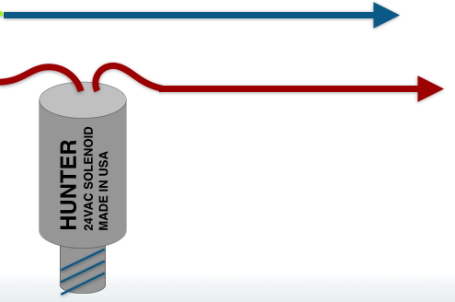

Field Troubleshooting
Check current at transformer
Check both red and blue wires
Look for differences

Slide 33
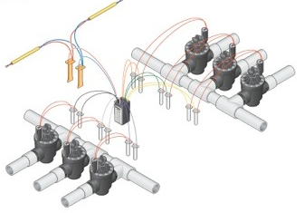
Field Troubleshooting
Check at Decoders along path

Slide 34
Field Troubleshooting
Follow wire, checking current along the way.
High Number
Number should drop a little
as you move down the line
Low Number

Slide 35
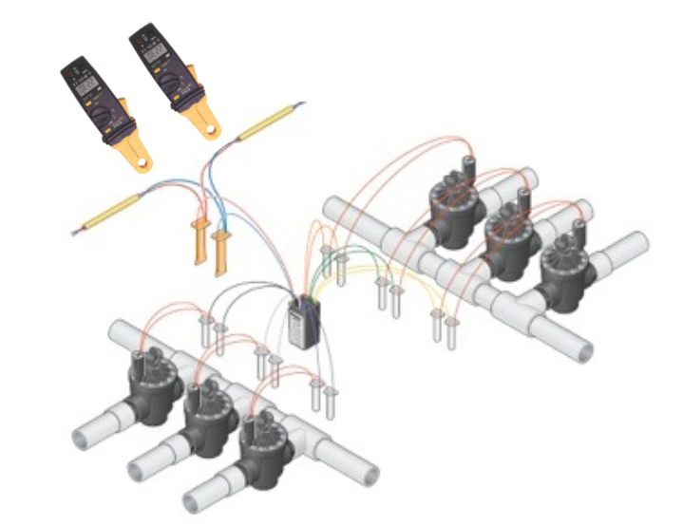
Field Troubleshooting
Find Short
High Number
Low Number
Short at either the Decoder or Ground

Slide 36
Field Troubleshooting
Find Open
Number
0 Reading
Number
Bad Splice or Broken Wire

Slide 37
Using Pre-existing Wire
This is strongly discouraged by Hunter for the following reasons:
• It is unlikely that the pre-existing wire meets the specifications for gauge, twist, and solid copper.
• Pre-existing wire will not be color-coded correctly for the decoder wires.
• Pre-existing wire may have invisible problems (shorts, breaks, increased resistance, or damaged insulation) that will be inherited by the new installation.
It is unwise to take chances on large projects by trying to "beat" wire specifications.

Slide 38
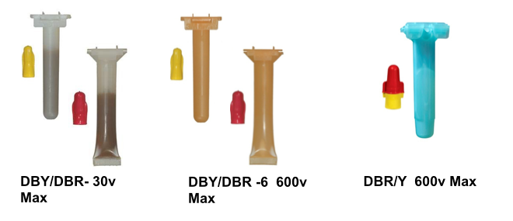
Splices
Observe Local Electrical Codes
NOT for 2 wire
Approved for 2 wire

Slide 39
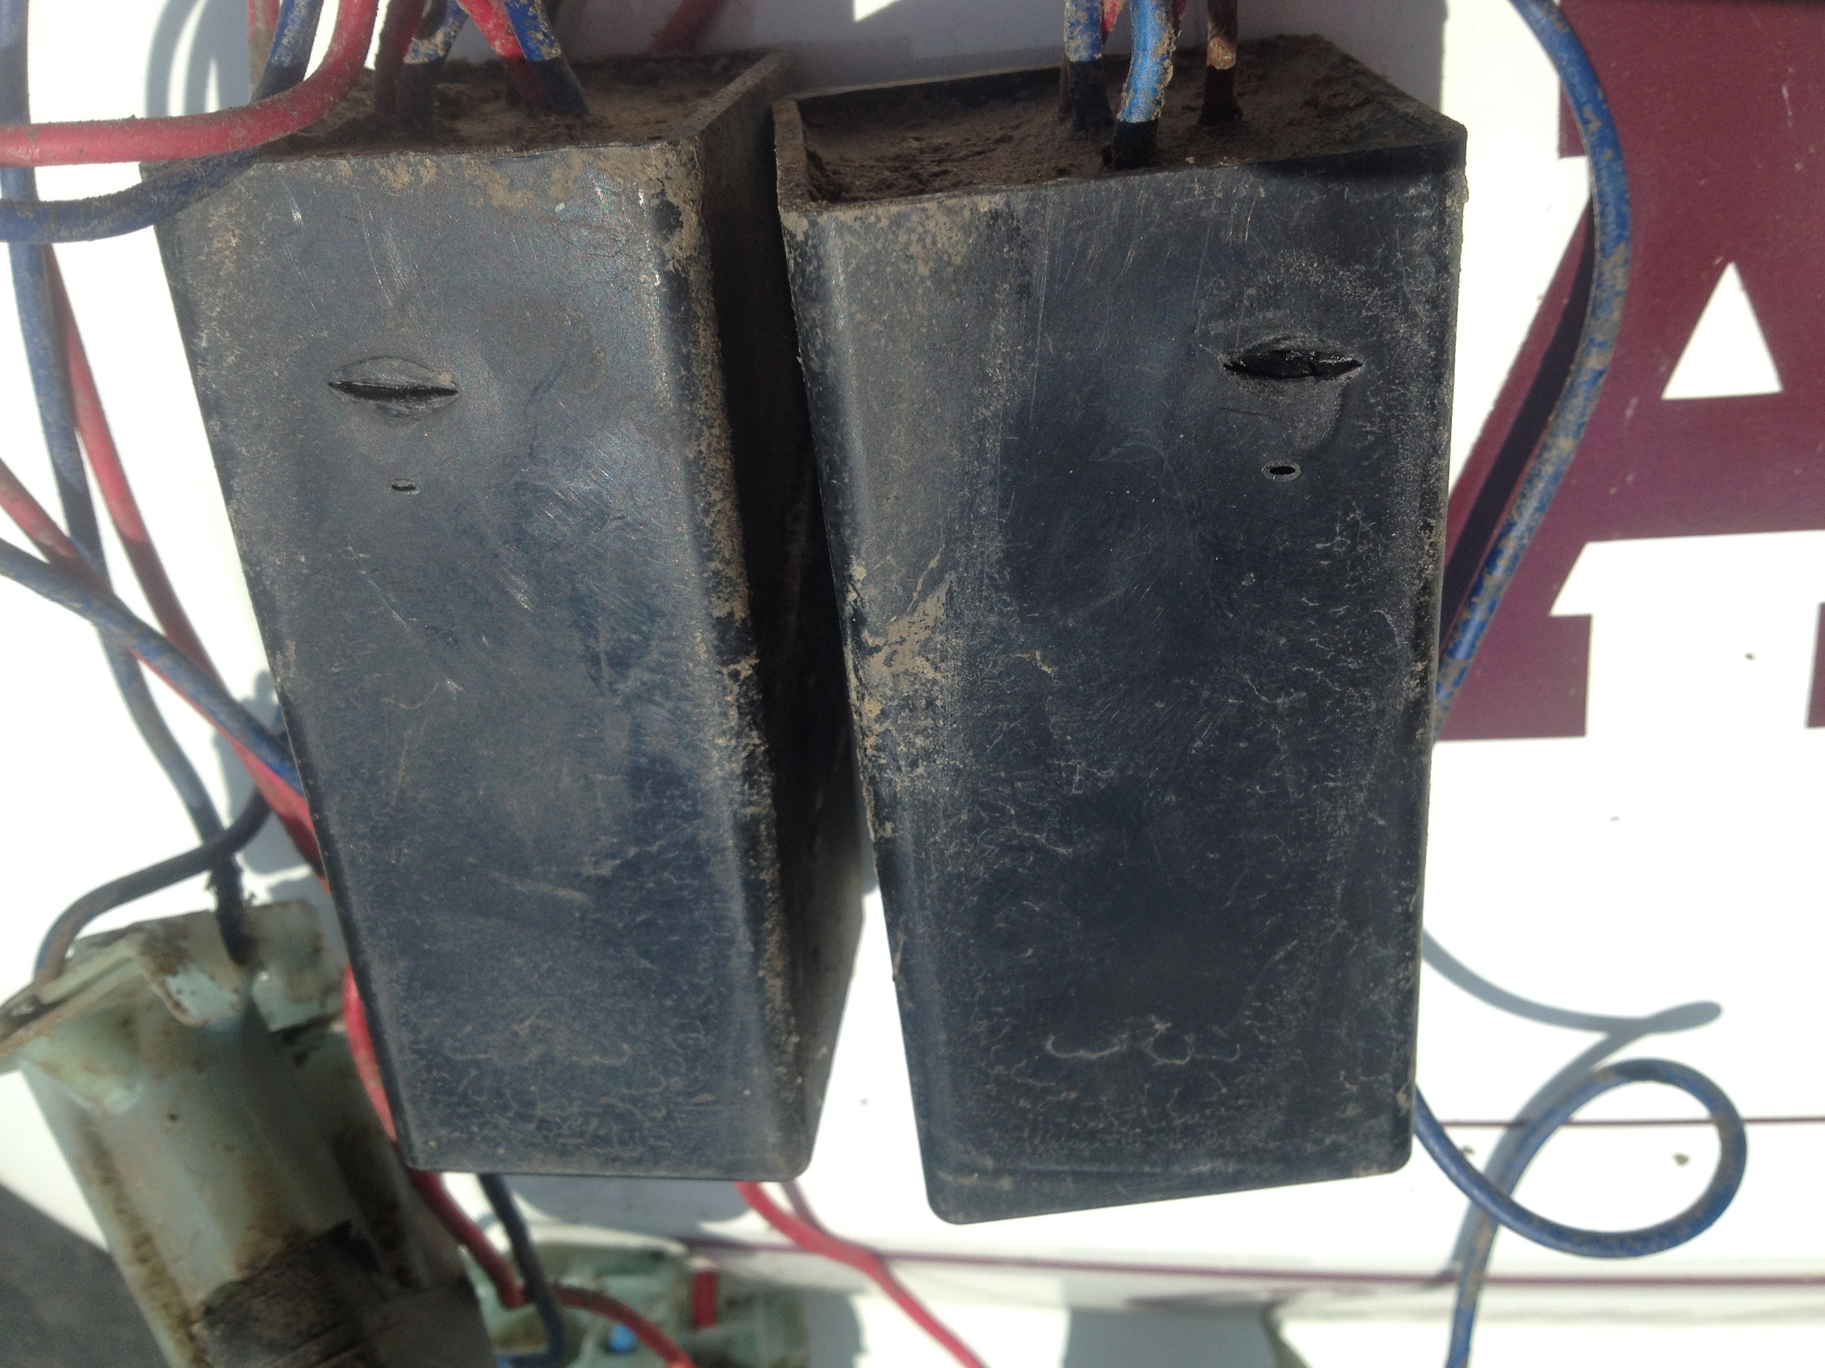
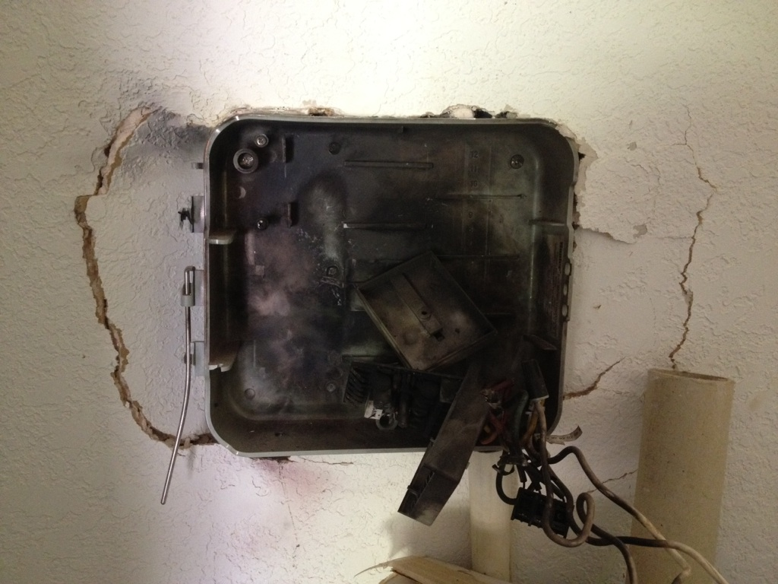
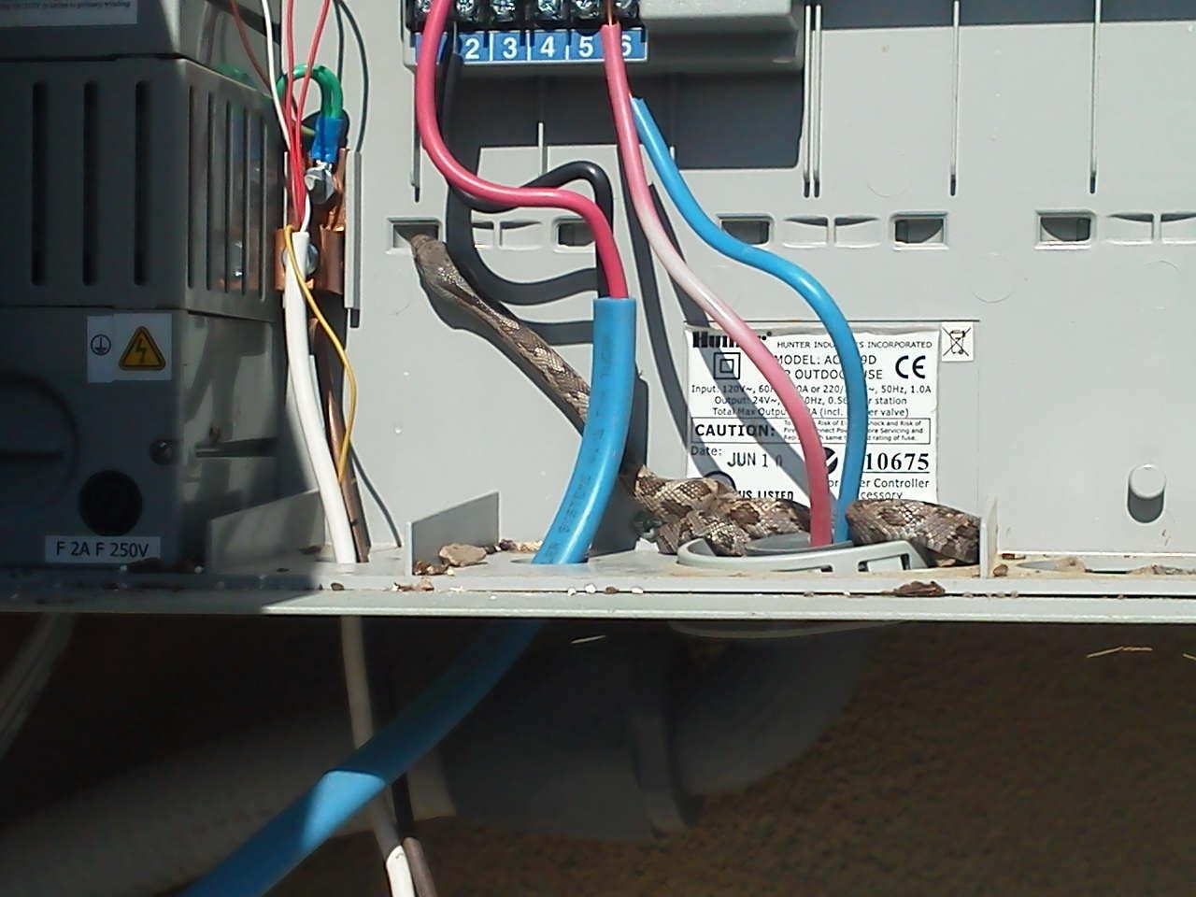
Thank You

