Slide 1
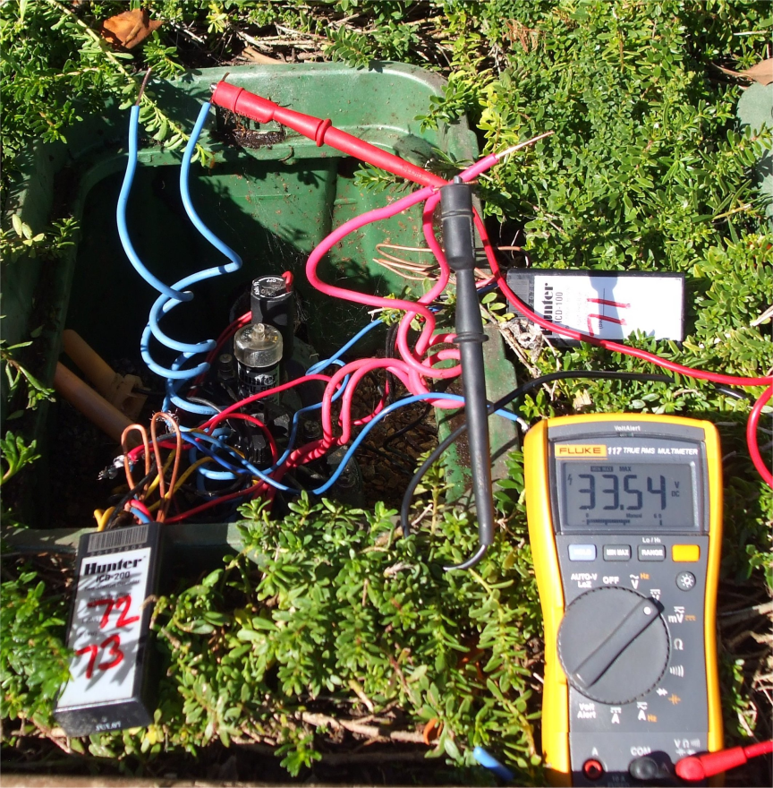
Tools

Slide 2
Fluke 117 Voltmeter
Extech Clamp On mA meter
Armada Clamp On mA meter
ICD-HP
24Vac/60Hz power source
Test decoder/solenoid
Armada Wire Tracker
Armada Ground Fault Locator
Ground Tester
T
O
O
L
S
Notes:
A list of tools that will help in troubleshooting different types of faults. Each one is described in the next slides. Mention that these are recommendations only, and highlight the required ranges of them for equivalent brands.

Slide 3
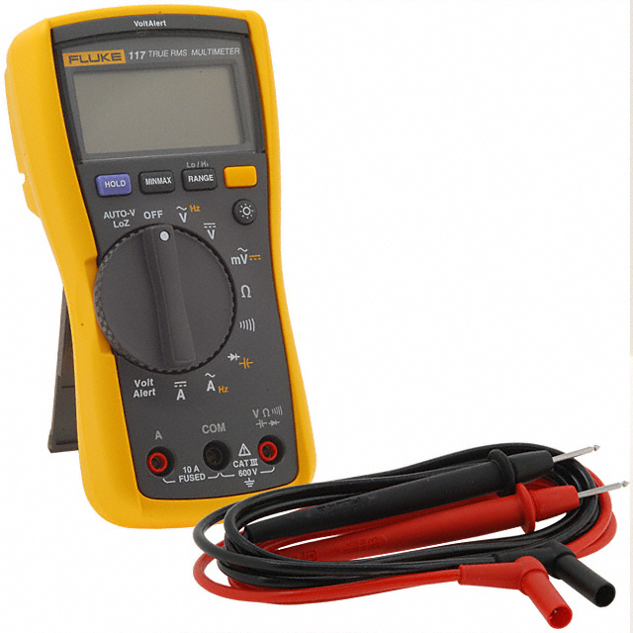
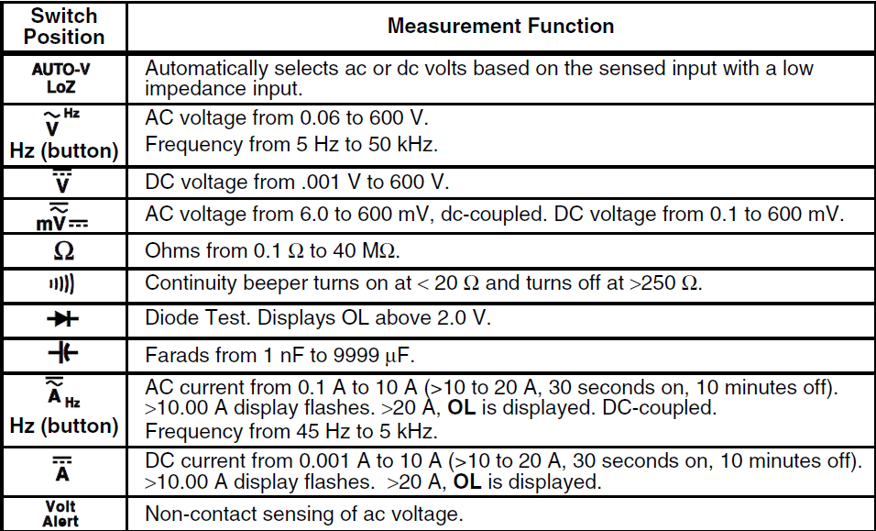

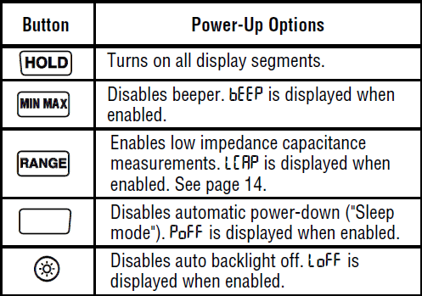
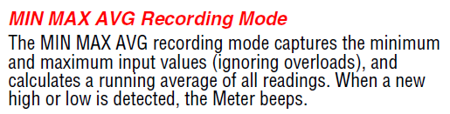
FLUKE 117 Voltmeter

Slide 4
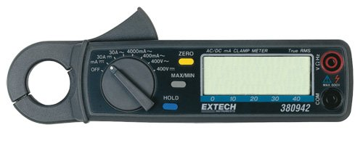
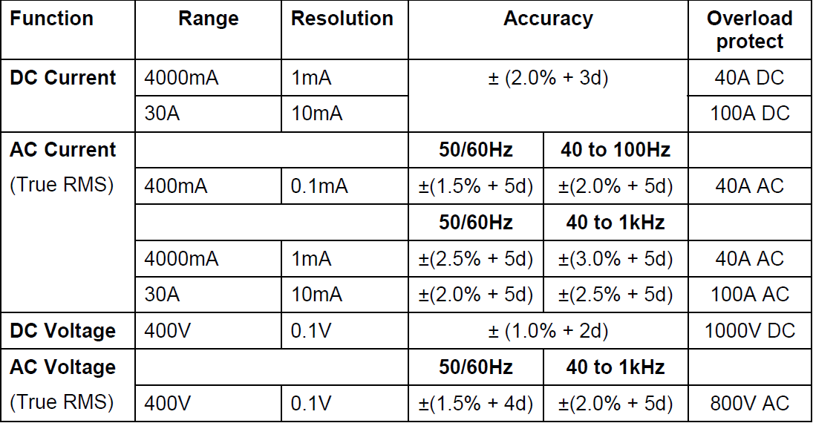
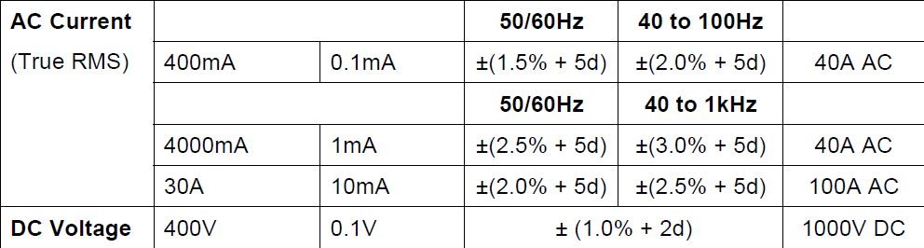
Extech 380942

Slide 5
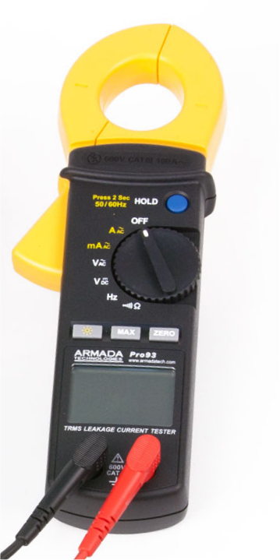
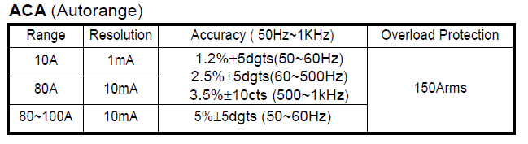
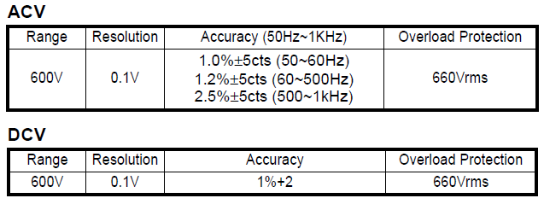

Armada Pro93

Slide 6
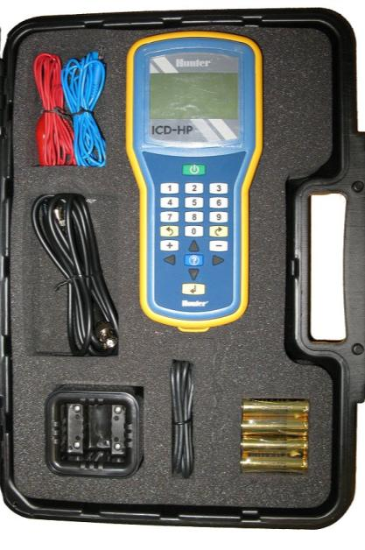
Hunter ICD-HP Features
Decoder Programming
Decoder Firmware
Diagnostics
Station Test
Clik/Flow Sensor Test
Volt / Amp Meter
Hunter ICD-HP

Slide 7
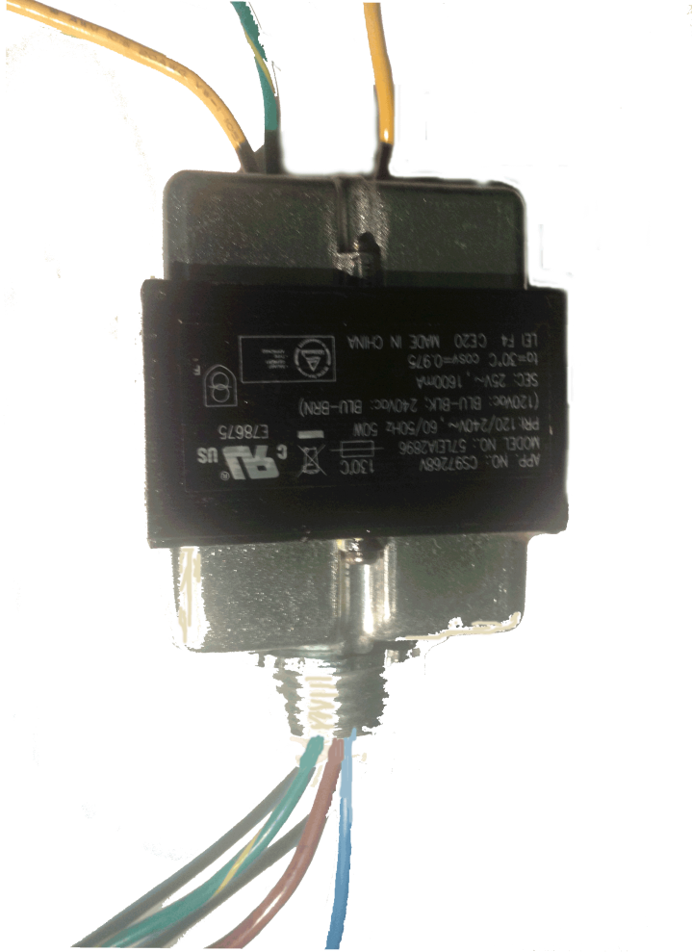
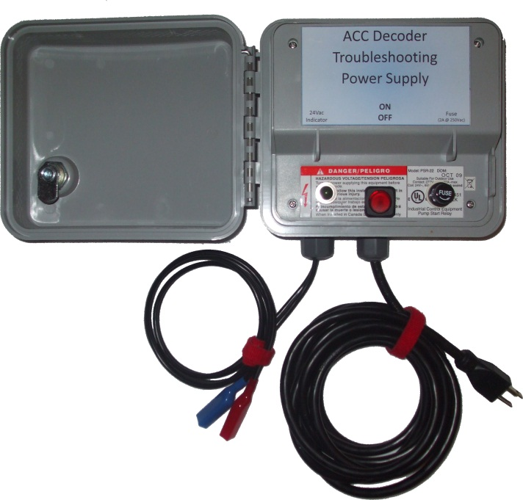
24Vac, 60Hz power source

Slide 8
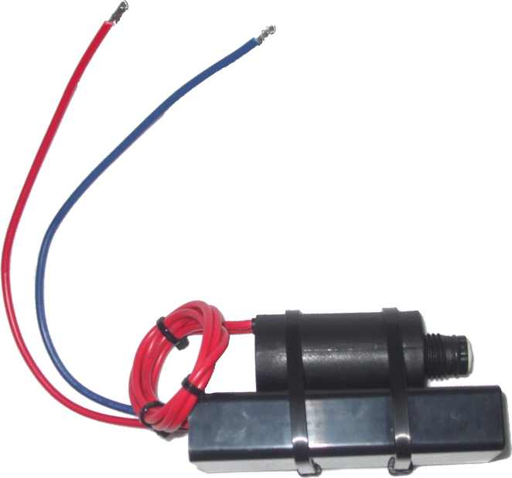
Test Decoder/solenoid

Slide 9
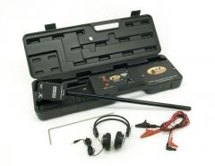
Pro300 Tracker

Slide 10
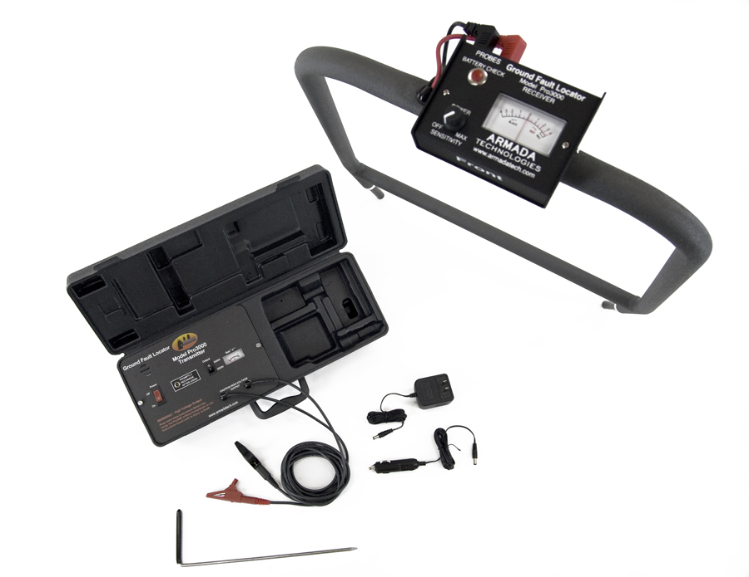
GFL3000 Ground Fault Locator

Slide 11
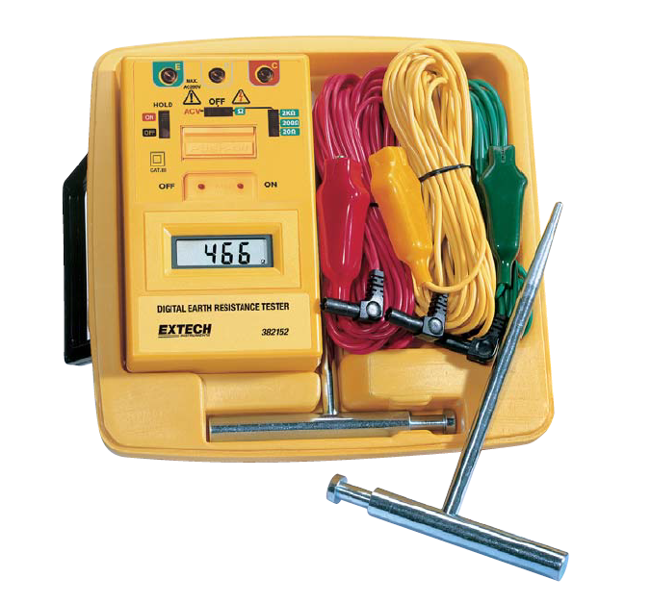
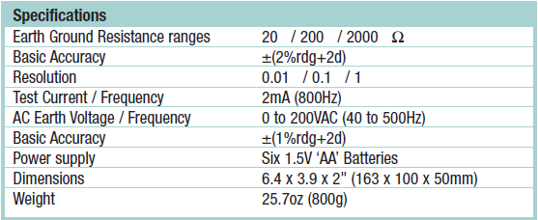
Extech 382153 Ground Tester

